Slide 1
Digital systems
Years 1–2 presentation material

Slide 2

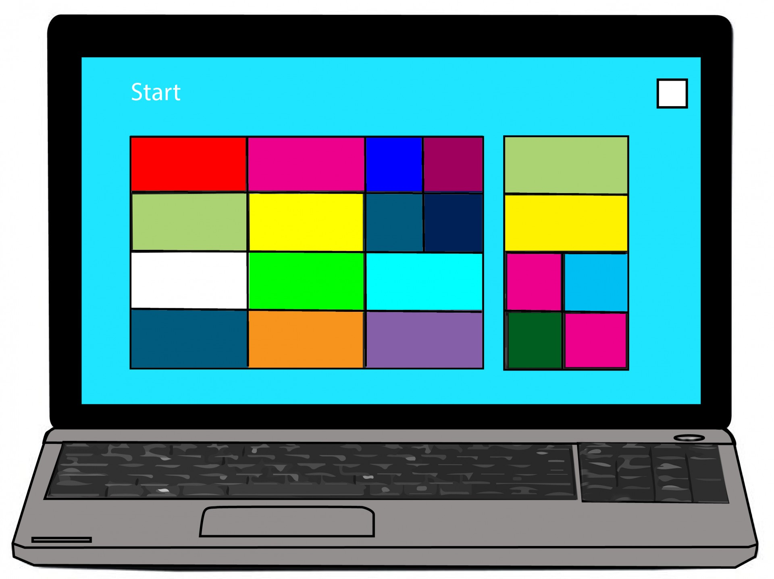
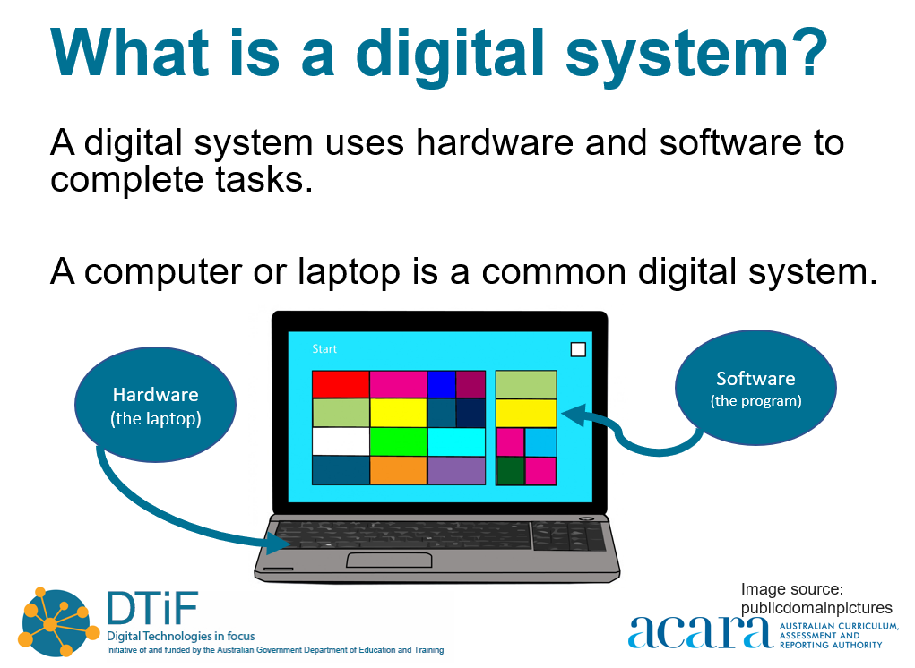
What is a digital system?
A digital system uses hardware and software to complete tasks.
A computer or laptop is a common digital system.
Software
(the program)
Hardware
(the laptop)
Image source:
publicdomainpictures

Slide 3
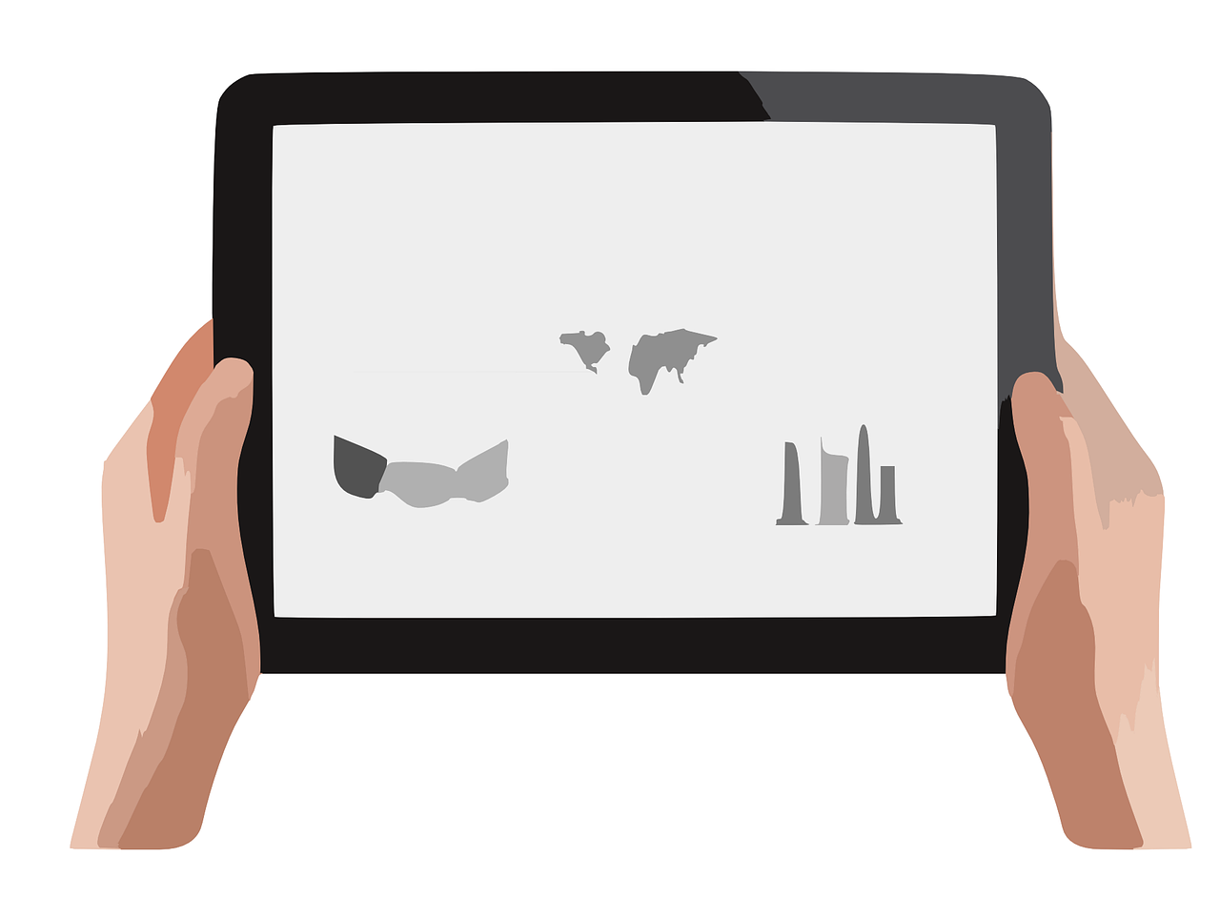
More digital systems
Software
(the app)
Hardware
(the tablet)
Image source:
NeedPix

Slide 4
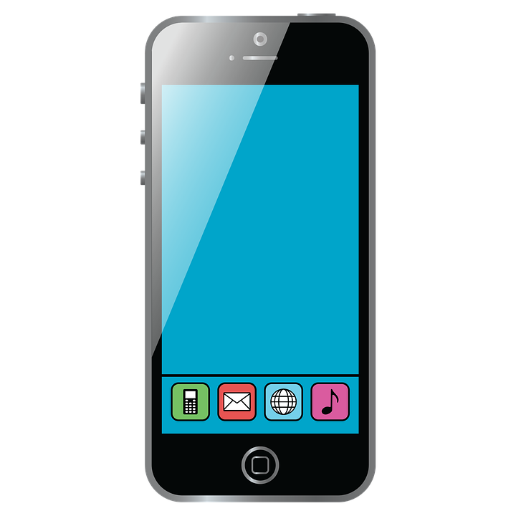
More digital systems
Hardware
(the phone)
Software
(the app)
Image source:
pixabay

Slide 5



Can you name these digital systems?
Notes:
Teacher note: This is intended as an activity for formative assessment purposes. This could be done as a whole group, small group, paired or individual activity. It can be verbal, recorded as a video or audio file or written in the portfolio booklet.
Tablet or iPad
SmartWatch / Mobile watch
Smart phone or Mobile phone or even iPhone
Computer or desktop computer.

Slide 6
Using a digital system:
Software and hardware
Notes:
There are two different teacher led methods following. I recommend the Google maps to be completed as a class first.
Then participate in a school walk and then complete the Scribble maps activity or repeat the school activity using the Google maps method.
Alternatively, you could do the activity on a piece of paper for students if you don’t have access to a digital screen or smart board to show students.

Slide 7
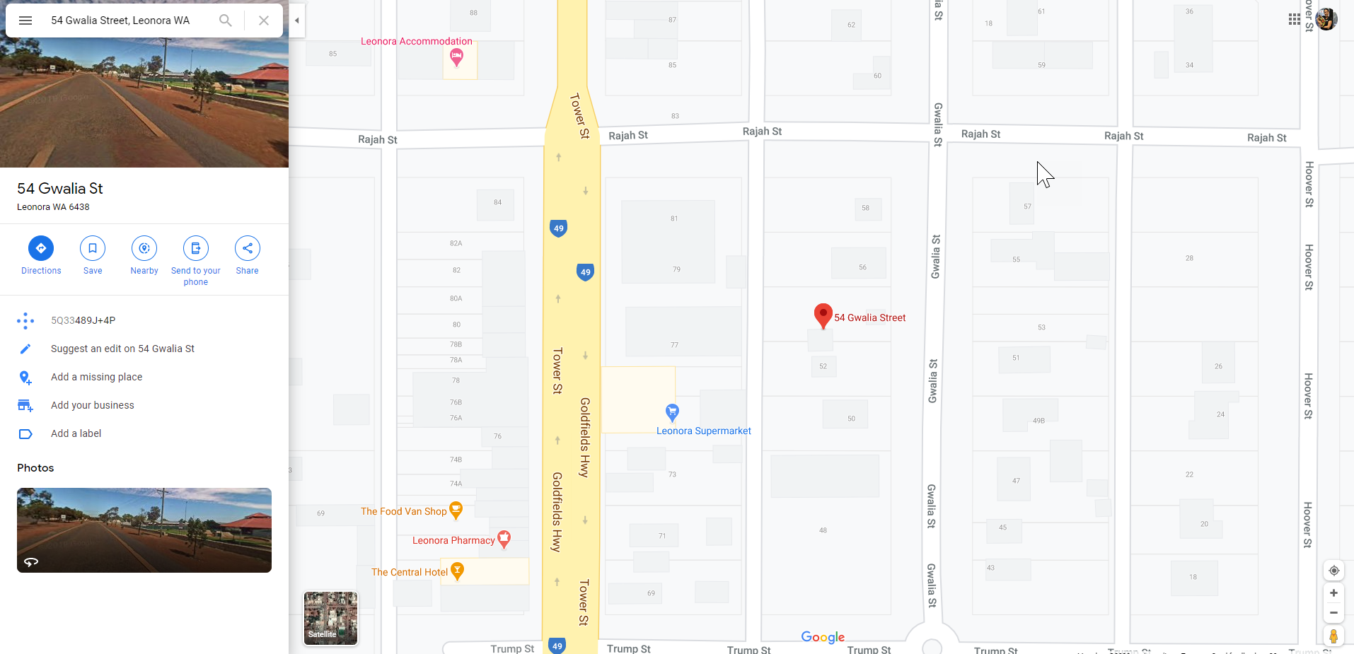
Google Maps
Go to www.googlemaps.com
Locate a local park.
Notes:
Use your own example

Slide 8
Google Maps
Select satellite.
• What has happened to the map?

Slide 9
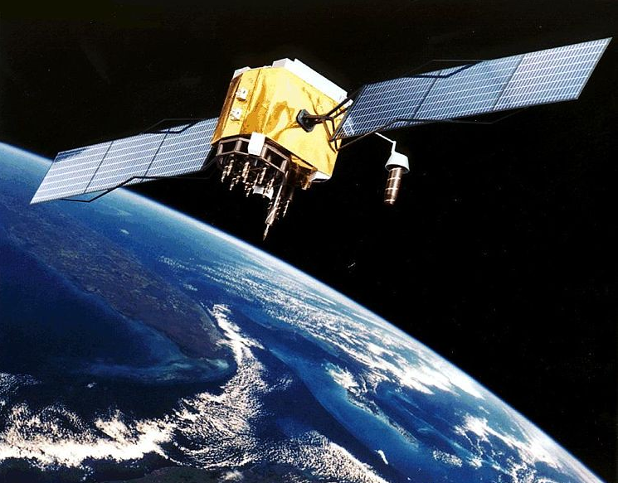
Google Maps – satellite view
Satellite – What is it?
Discuss with students what a satellite is.
NASA states that a satellite is a moon, planet or machine that orbits a planet.
Image source:
flickr
Notes:
The satellite and aerial images in Google Earth are taken by cameras on satellites and aircraft.
Image
https://www.flickr.com/photos/vthokiefans/3147647393

Slide 10
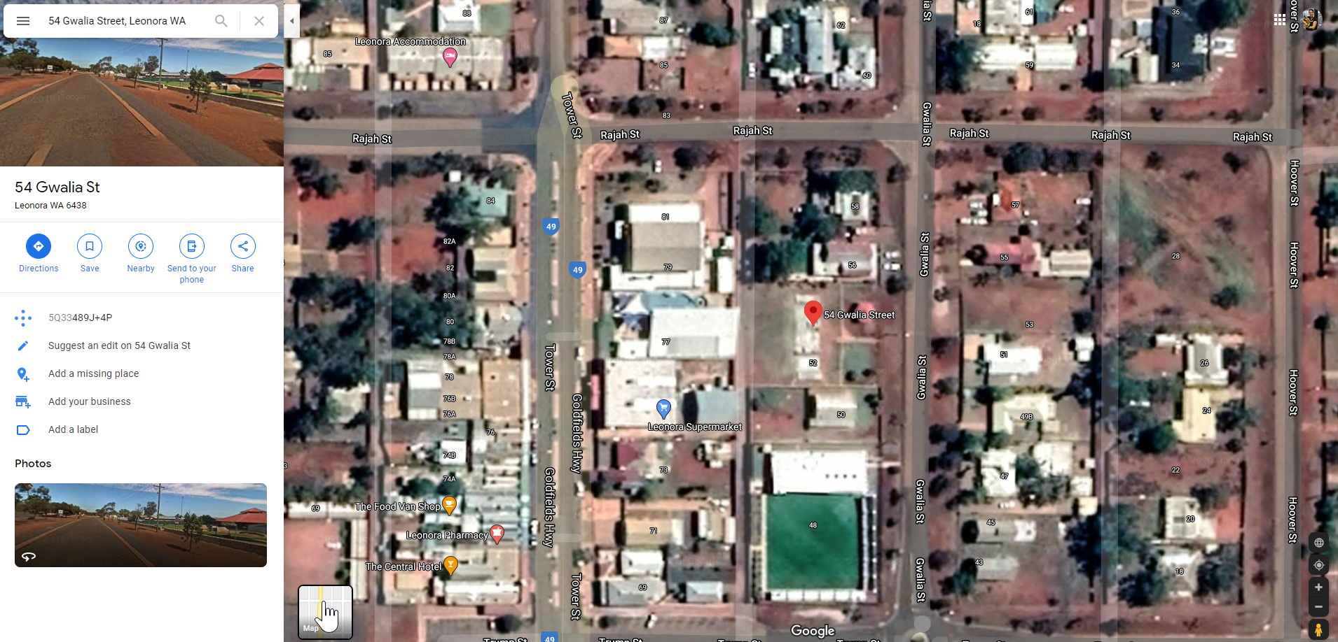
Google Maps
Let’s zoom into the park.
(Use the + sign.)
Notes:
Discuss what is different with a satellite map to a street view map.
Create a list of words that describe differences.
Then zoom into the park – use + or the mouse wheel.
#Remember to talk about what you are doing as you zoom into the image. Great geographical language students can learn as you use the tools.

Slide 11
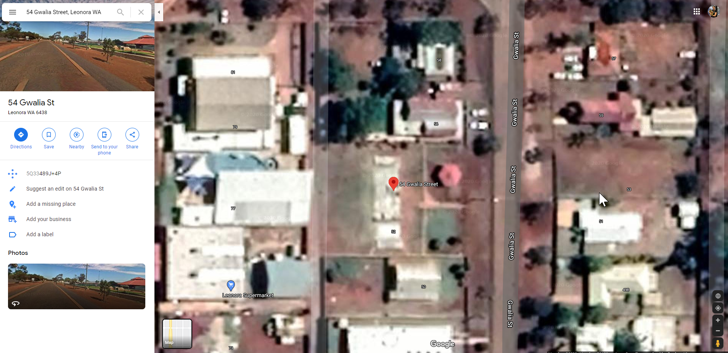
Google Maps
Let’s take a screen capture of the picture.
Notes:
Please identify before the lesson what your computer can do to screen capture. Search for a Snipping tool or Snaggit or the keyboard may have a ‘Print Screen’ button. The picture is usually saved to your clipboard.
Then paste the pic to a blank PowerPoint page or another Interactive tool that will allow you to easily add images over the top of this satellite image.
I can select the parts of the image I want to use with my Screen capture tool. If your program does not allow that you could ‘crop’ the image to just the park after you paste it.

Slide 12
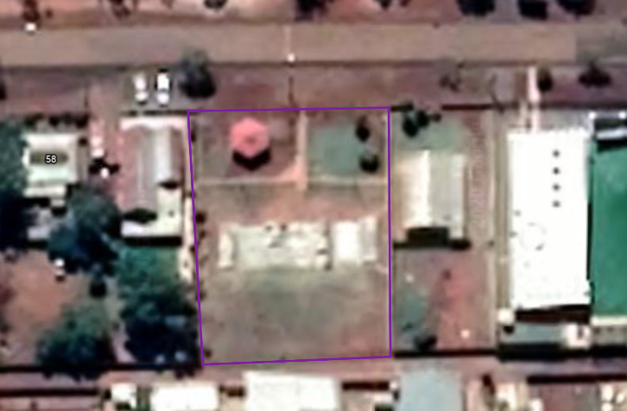
Google Maps
Leonora Skate Park
• How many trees are there?
Notes:
Step 1: Students can now count how many trees in the park.

Slide 13

Google Maps
Leonora Skate Park
• How many trees are there?
Notes:
Step 2: Depending on the device you are using you may be able to use a digital pen to circle each tree, or add an icon to the image.
I am using tree icons for this. Go to: Insert > Icons – type tree. Select one.
It will place it in as black. You can resize tree and change the colour of the tree icon. Right click on the icon > select Fill > choose colour
For additional trees If you right click the green tree you could paste a new one.

Slide 14

Google Maps
Leonora Skate Park
• Where could we plant trees?
Notes:
Step 3: Where could we plant trees to increase shade?
If you right click the green tree you could paste a new one. Then simply change the colour again to show proposed trees.
Obviously some trees differ in size so we are being very non-specific and using icon size to calculate trees.

Slide 15
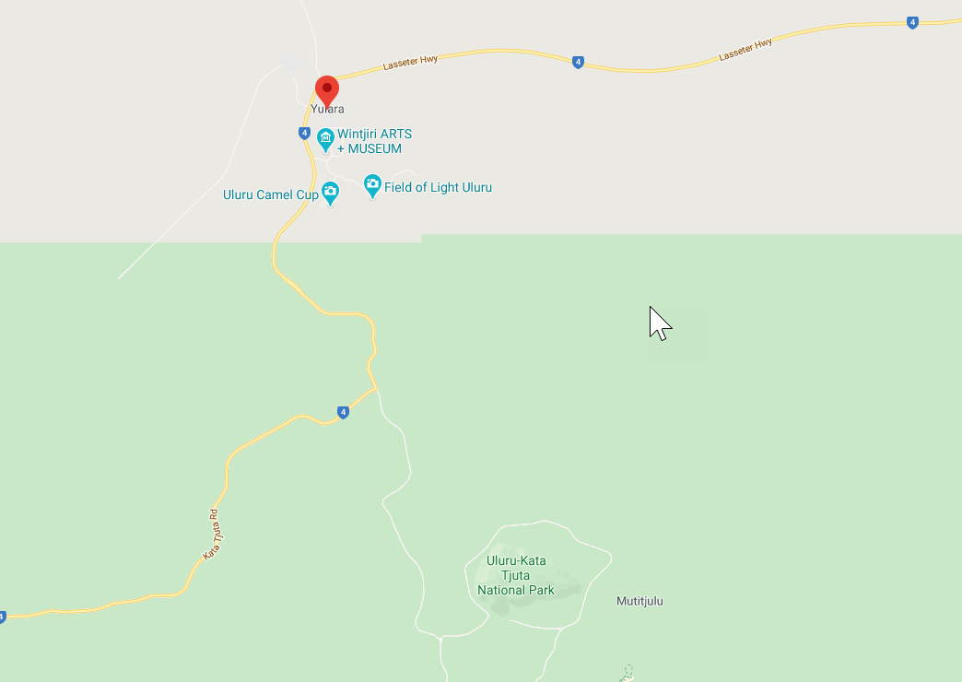
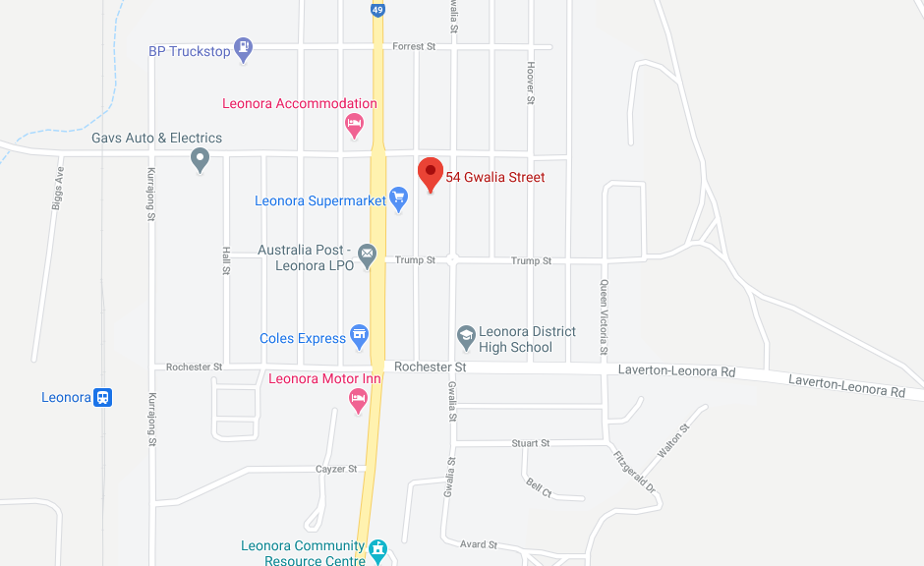
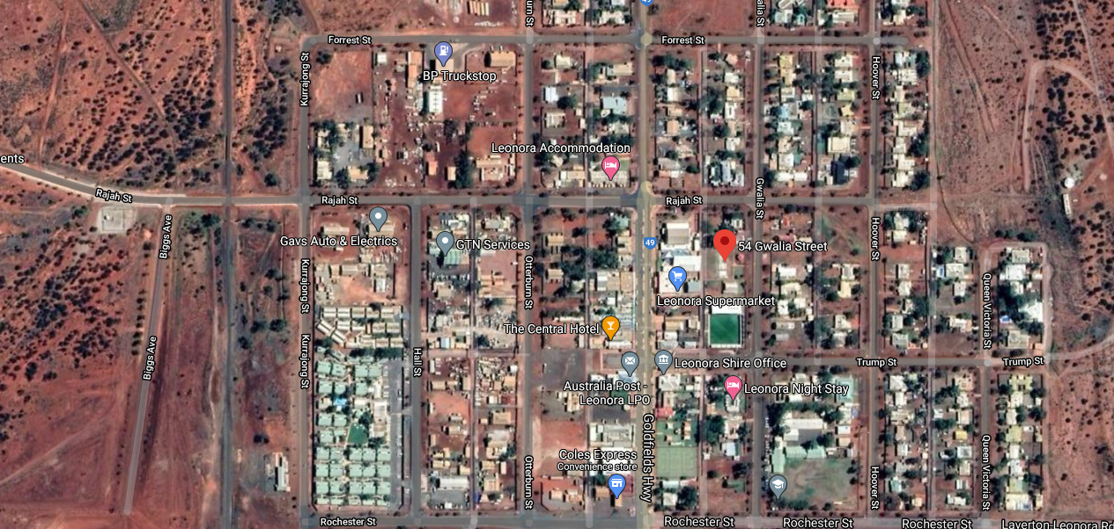
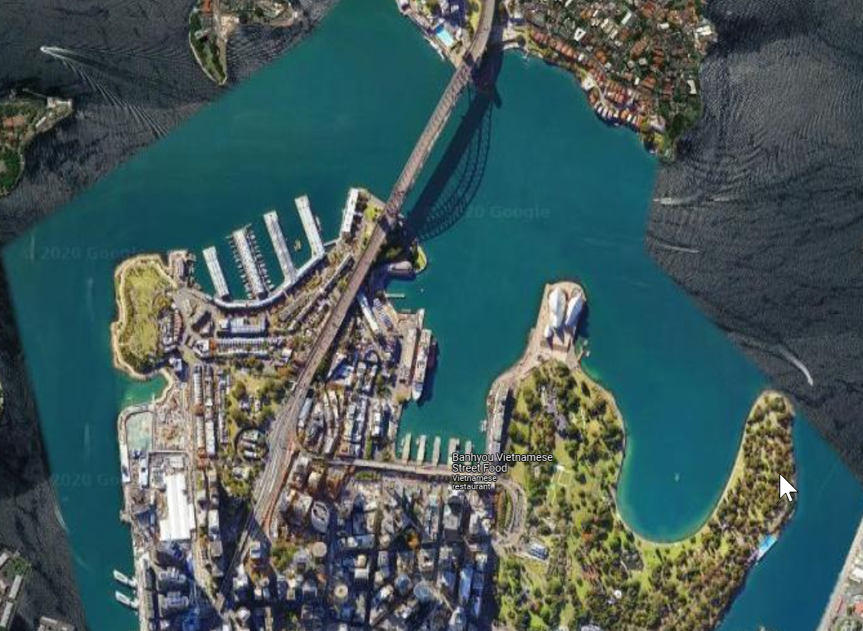
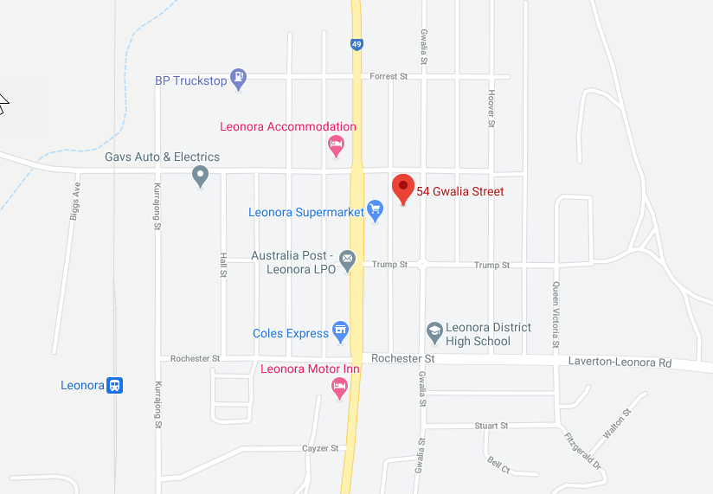
Can you name these types of maps?
Satellite map
Street map
Notes:
Teacher note: This is intended as an activity for formative assessment purposes. This could be done as a whole group, small group, paired or individual activity. It can be verbal, recorded as a video or audio file or written in the portfolio booklet.
Satellite – Leonora WA
Street – Leonora WA
Street - Yulara NT
Satellite – Sydney NSW

Slide 16


ScribbleMaps
Go to scribblemaps.com and select:
www.scribblemaps.com
Notes:
Teacher note: This is intended as a teacher led activity. However, this could be done as a small group, paired or individual activity depending on students' skills and classroom device resources.

Slide 17
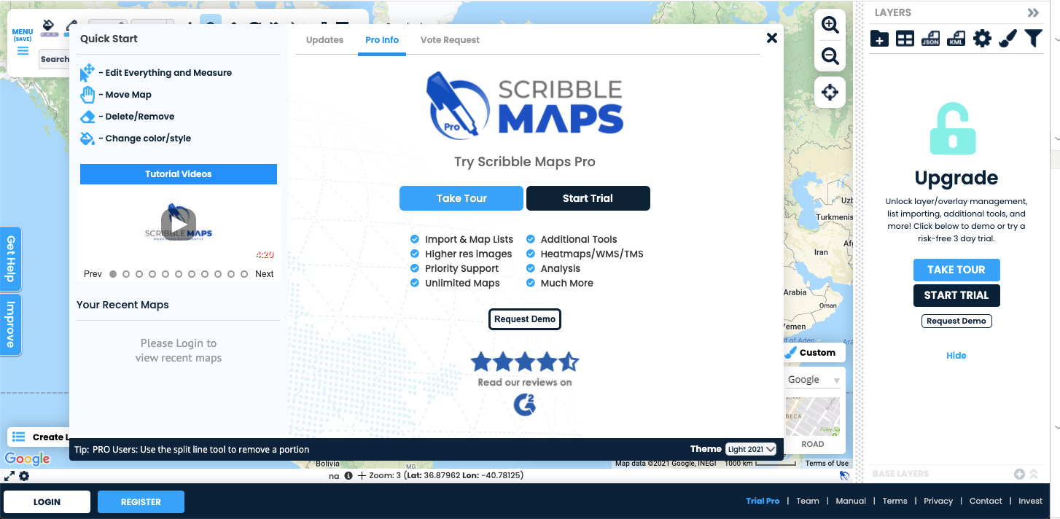
ScribbleMaps
Click on the X to close the pop-up window.
www.scribblemaps.com/
Notes:
Close this screen down

Slide 18
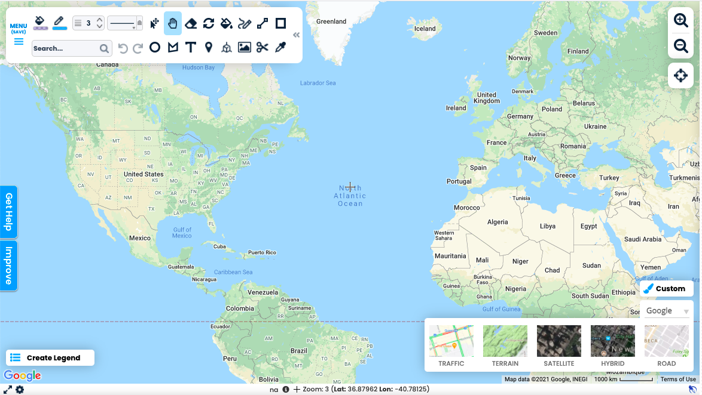
ScribbleMaps
Click on satellite to change the view.
www.scribblemaps.com/
Notes:
Close this screen down

Slide 19
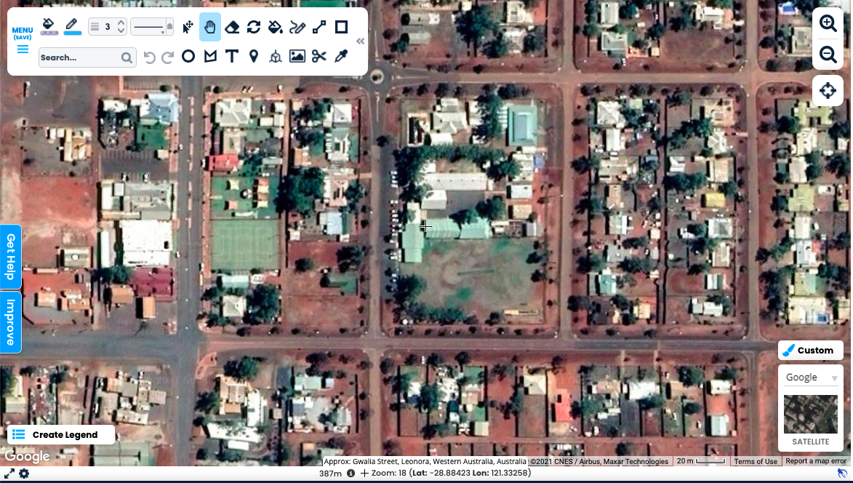
ScribbleMaps
Type your school address.
Then zoom in using the mouse wheel or the + sign.
www.scribblemaps.com
Notes:
Teacher note: type in the school address

Slide 20
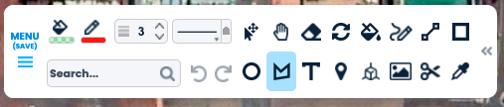
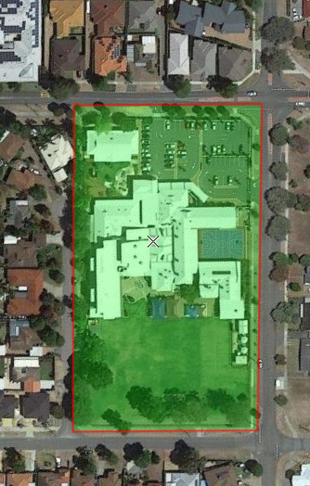
ScribbleMaps activity
Select change fills– change opacity % to 25.
Use the polygon tool to draw a polygon or line around the perimeter of your school.
Double-click mouse to finish drawing polygon
or line.
Notes:
Teacher note: If the teacher is doing this be sure to teacher talk as you do it.
Task: Highlighting the area you are focusing on.

Slide 21
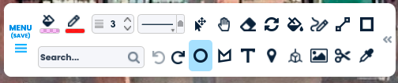
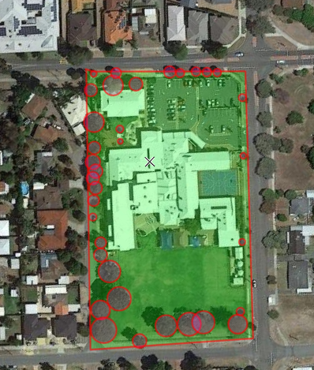
ScribbleMaps activity
Select change fills – change colour to pink and opacity % to 25.
Use the circle tool to draw a circle over each tree.
Notes:
Teacher note: Be sure to notice if the tree has shade and don’t circle that also. Discuss this with the students – zoom in close if need be.
Task : Identify the trees: To create circle start in the middle of the tree area – click and drag out.

Slide 22

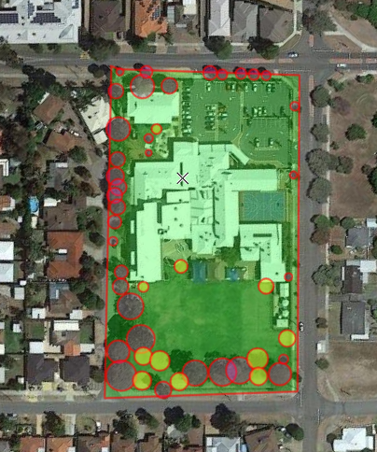
ScribbleMaps activity
Select change fills – change colour to yellow and change opacity to 50%.
Use the circle tool to draw a circle over each tree.
Notes:
Teacher note: Be sure to notice if the tree has shade and don’t circle that also. Discuss this with the students – zoom in close if need be.
To create circle start in the middle of the tree area – click and drag out.
Task: Add trees that could be planted in locations.

Slide 23

ScribbleMaps activity summary
Use ScribbleMaps to look at your school in satellite view.
Locate your school.
Zoom into your school.
Use the polygon tool to draw around the school.
Draw red circles around the trees in a colour.
Draw yellow circles where new trees could be planted.
Take a screen capture of your map. Share the map online – you could use AirDrop or the classroom digital portfolio app.
Notes:
Teacher note: This is intended as an activity for formative assessment purposes. This could be done as a small group, paired or individual activity.
Can use tablets or computers. The image could also be printed off for students to draw around or place stickers on.
The image can also be AirDropped to devices and use the MarkUp function in camera or utilize a drawing app such as book creator to follow steps d & e.
F: An additional step for the students would be to share their map (digital or unplugged) with a safe online environment. This could be as simple as air-playing to the class digital whiteboard or upload to a digital portfolioing program (eg: Seesaw or Class Dojo).

Slide 24



ScribbleMaps activity
How could you use ScribbleMaps to help your local community?
Image source: pixabay
Notes:
Teacher note: This is intended as an activity for whole class formative assessment purposes. Answers could include: to see where we could plant more trees, to see where it would be good to set up sporting or off-leash dog exercise areas, to see where we could run the cross-country trail, to plan where to build a nature reserve or additional buildings, etc.

Slide 25

Group task – compare data
What was the largest number of trees that could be planted?
Why?
What was the smallest number of trees that could be planted? Why?
What was the most common number of trees? Why do you think that was?
Notes:
Collating the class data on how many trees can be planted as suggested by each student then host a discussion about the data. What was the most / least amount of trees that could be planted? Why? What was the most common number?
Teacher note: This is intended as an activity for whole class formative assessment purposes. It could also be done as a think-pair-share activity. The ultimate goal of this activity is for students to analyse the data they created.

Slide 26
Digital assessment portfolio
Items that could be included in a digital portfolio or digital book:
map of local area or school with existing trees identified
map of local area or school with suggested tree planting identified
oral recording of student explaining why they think the extra trees could be planted where they placed them
images of the class data and the actual location that trees could be planted
Notes:
If maps used by students are printouts – students can take a picture of the completed work and place in a digital portfolio as suggested above.

Slide 27
Purposeful audience
Students could share their tree planting designs with an authentic audience.
Consider inviting people to view the students’ work.
School – other class, Principal, administration staff, gardener
Local government people responsible for tree planting and local gardens
Local environmental group or industry that
plants trees
Families
Notes:
If maps used by students are printouts – students can take a picture of the completed work and place in a digital portfolio as suggested above.

