Slide 1



Instructions for facilitators
Review the facilitator notes and ensure you have made any necessary changes to the PowerPoint slides.
Discussion points through the presentation will be identified using this icon.
When planning the presentation, consider the timing of the whole presentation, including time required for discussions.
This presentation uses 3 videos as stimuli for reflection and discussion. Consider the timing of these videos when planning the presentation.
  The three dimensions of the Australian Curriculum (5:08 minutes)
  General capabilities (4:24 minutes)
  Cross-curriculum priorities (3:33 minutes)

Slide 2
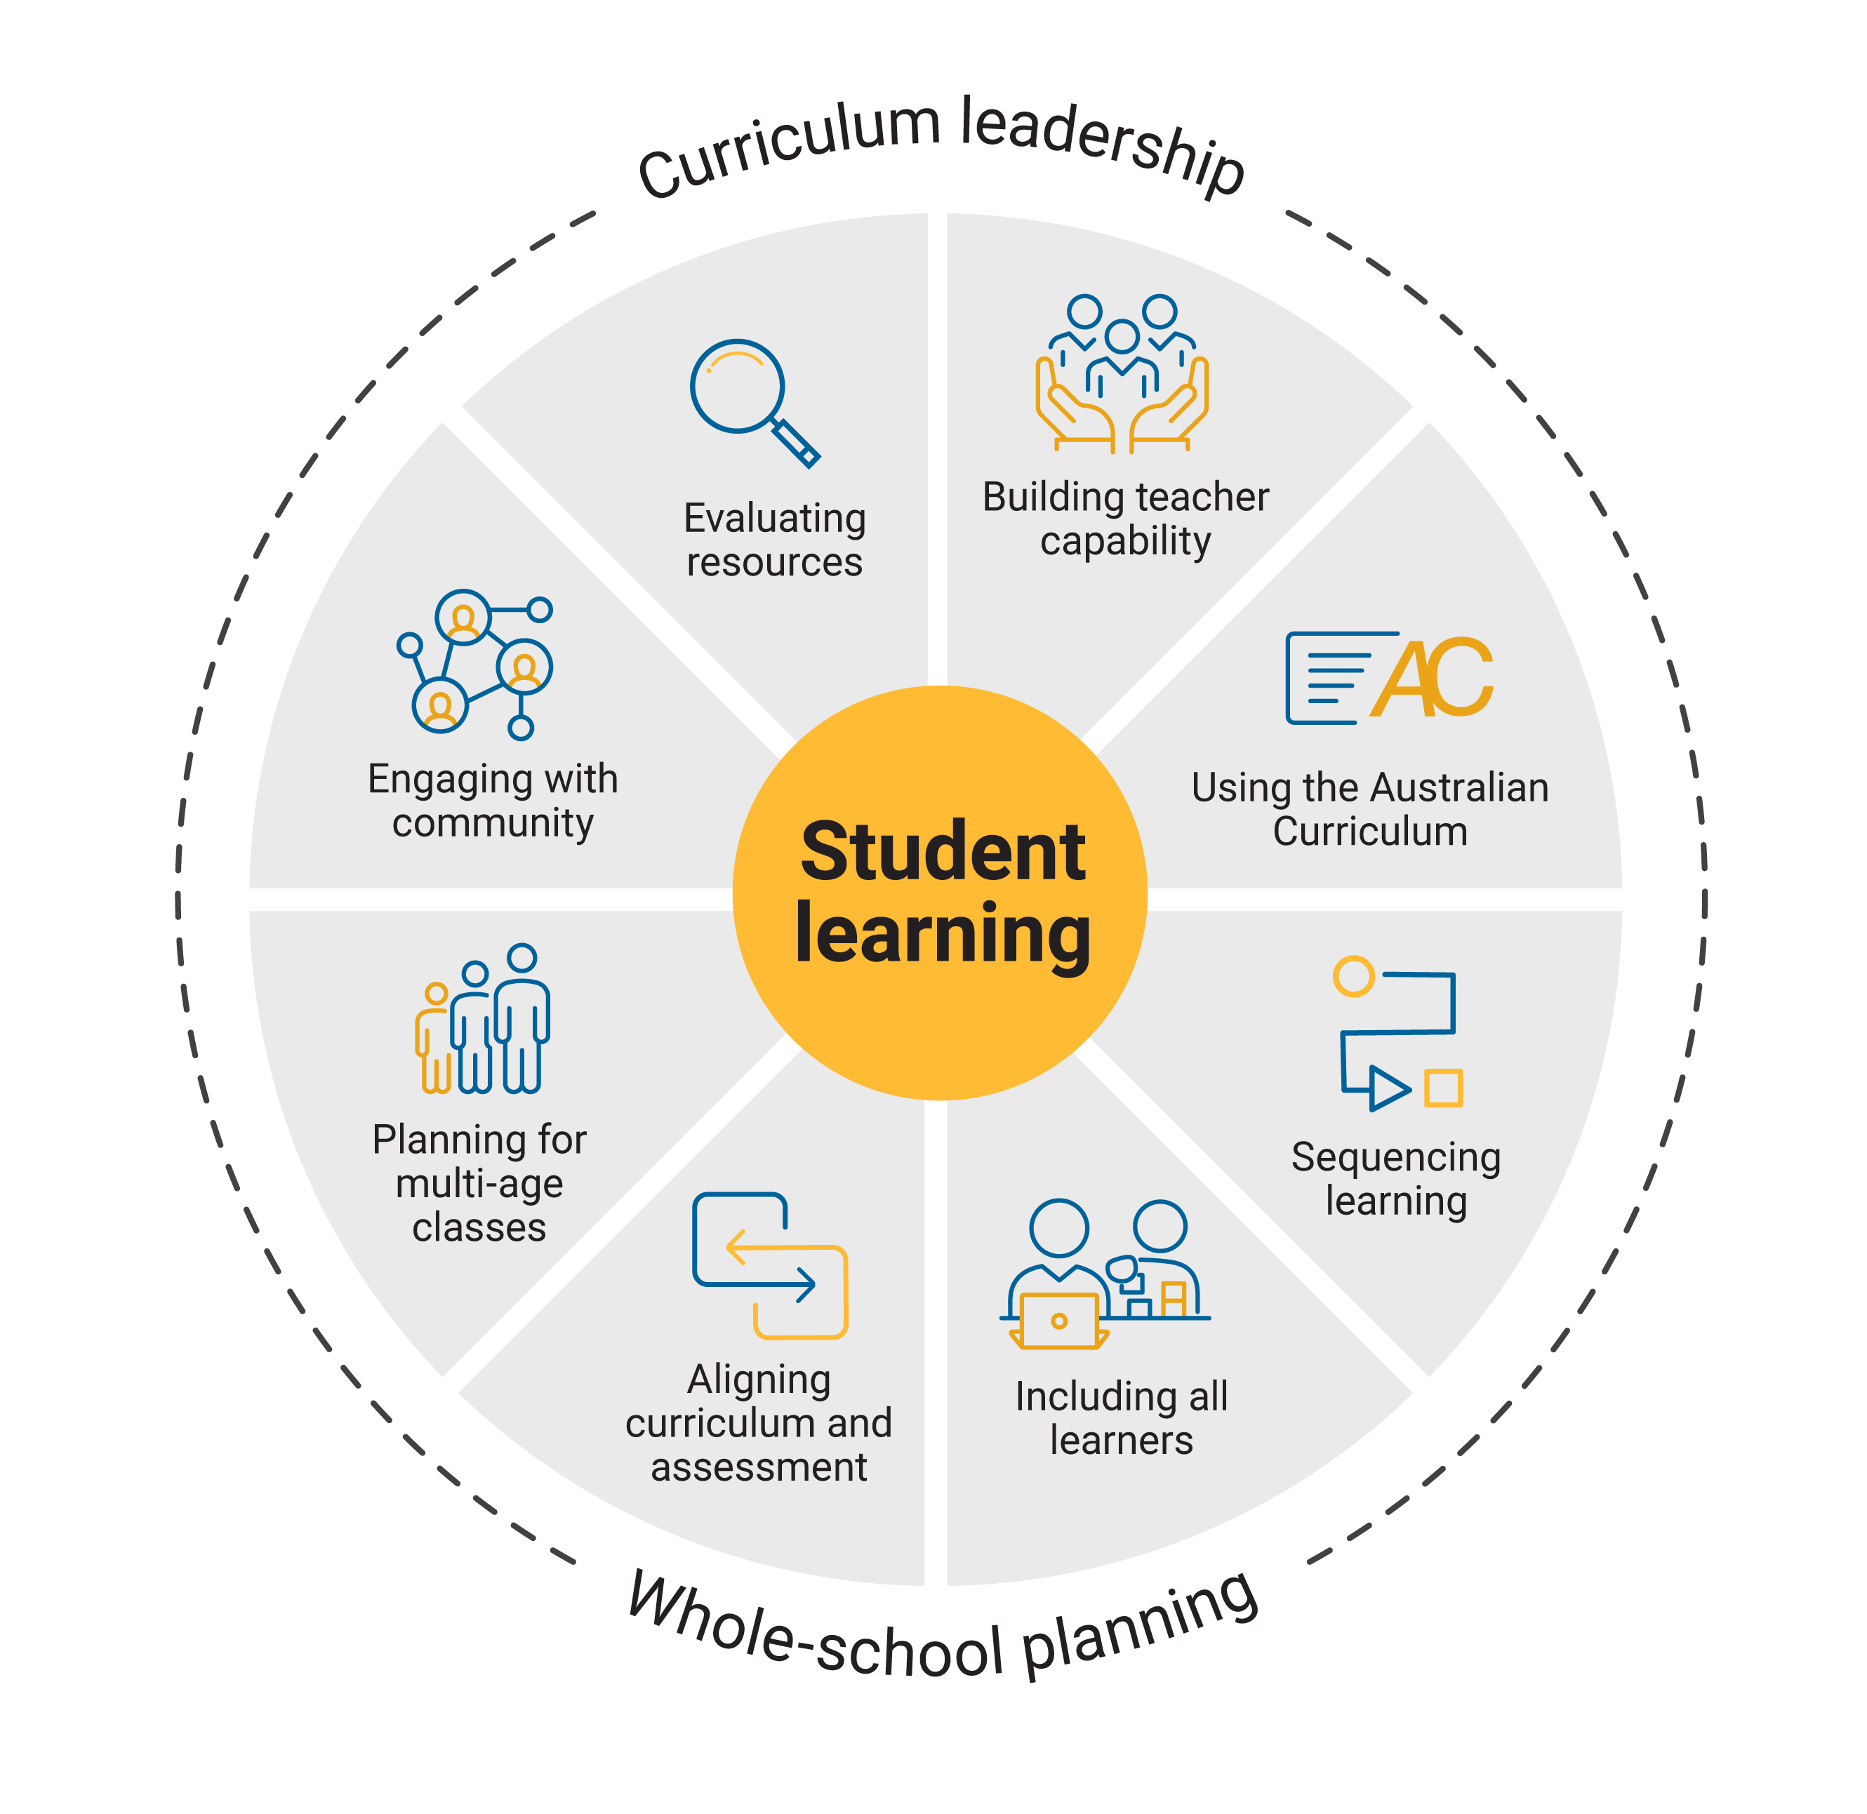

Using the
Australian Curriculum
Notes:
Speaker notes
This presentation is an overview of the Australian Curriculum learning areas, general capabilities and cross-curriculum priorities.

Slide 3

Outcomes
By the end of this workshop, we will have:
reflected on what we know about the Australian Curriculum
identified how we are using all parts of the curriculum in planning
proposed actions for change or improvement.
3
Notes:
Speaker notes:
Clarifying expected learning up front helps keep discussions focused and supports good decision-making.
NOTE: To prepare for this part of the presentation, review the text on screen and adjust or adapt for your school context.

Slide 4
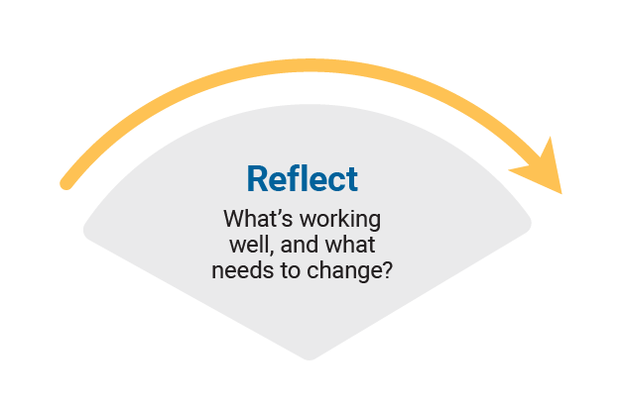
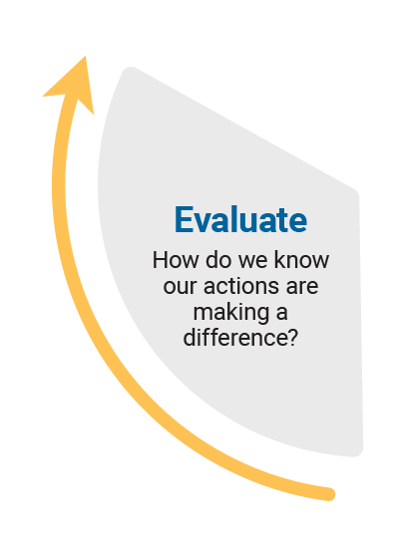
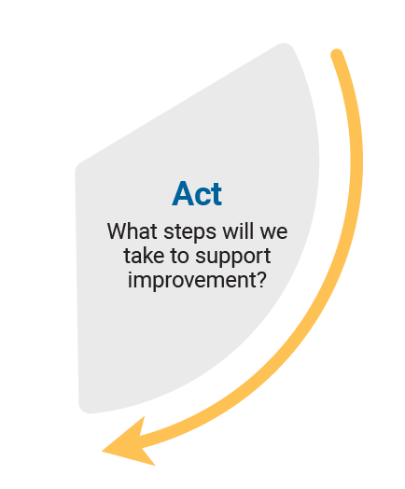
Reflect–Act–Evaluate
Reflect: identify current practice and needs.
Act: use insights from the reflect phase to determine actions to be taken.
Evaluate: identify the measures for evaluation and schedule evaluation points.
Notes:
Speaker notes
Explain to participants that the presentation will focus on the Reflect–Act–Evaluate cycle.
This is an opportunity for all participants to:
provide their insight into current practice
contribute to and enact whole-school plans
offer their observations and feedback in the evaluation process.
Explain the purpose of each stage.
Reflect: identify current practice and needs.
Act: use insights from the reflect phase to determine actions to be taken.
Evaluate: identify the measures for evaluation and schedule evaluation points.

Slide 5
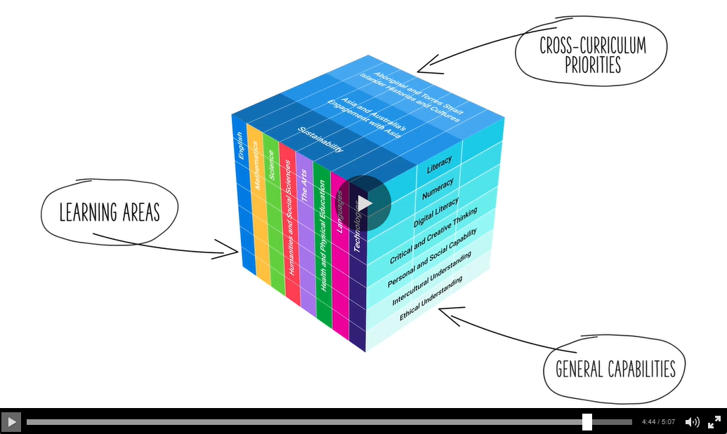
The three dimensions of the Australian Curriculum video
As we watch the video reflect on the ways we currently use the curriculum when planning.
Notes:
The three dimensions of the Australian Curriculum video: https://s7ap1.scene7.com/s7viewers/html5/VideoViewer.html?asset=australiancurriculum/The three dimensions of the Australian Curriculum-AVS
This link will open in a separate browser.
Speaker notes
The Australian Curriculum is 3-dimensional; it includes learning areas, general capabilities and cross-curriculum priorities. Together, these set out the essential knowledge, understanding and skills all young Australians need so they will be able to learn, contribute and shape their world now and in the future.

Slide 6

The Australian Curriculum
Reflect on the ways we use the curriculum and consider where we might like to improve our knowledge and expertise.
How well does our current curriculum planning reflect the intent and structure of the Australian Curriculum?
Think–Pair–Share
Think independently about a prompt or problem.
Pair up and discuss your ideas with a colleague.
Share your ideas with the group.
6
Notes:
To prepare for this part of the presentation review the text on screen and adjust or adapt for your school context
Speaker notes
After watching the Australian Curriculum video use the Think–Pair–Share activity to support participants to reflect on the ways they use the curriculum. Ask participants to consider where they might like to improve their curriculum knowledge and expertise.
Sharing may consist of only one idea or statement from each group for larger teams or using digital tools to record responses.
Activity
Think–Pair–Share: how to use it
Participants:
Think independently about a prompt or problem.
Pair up and discuss their ideas with a colleague.
Share their ideas with the group.

Slide 7
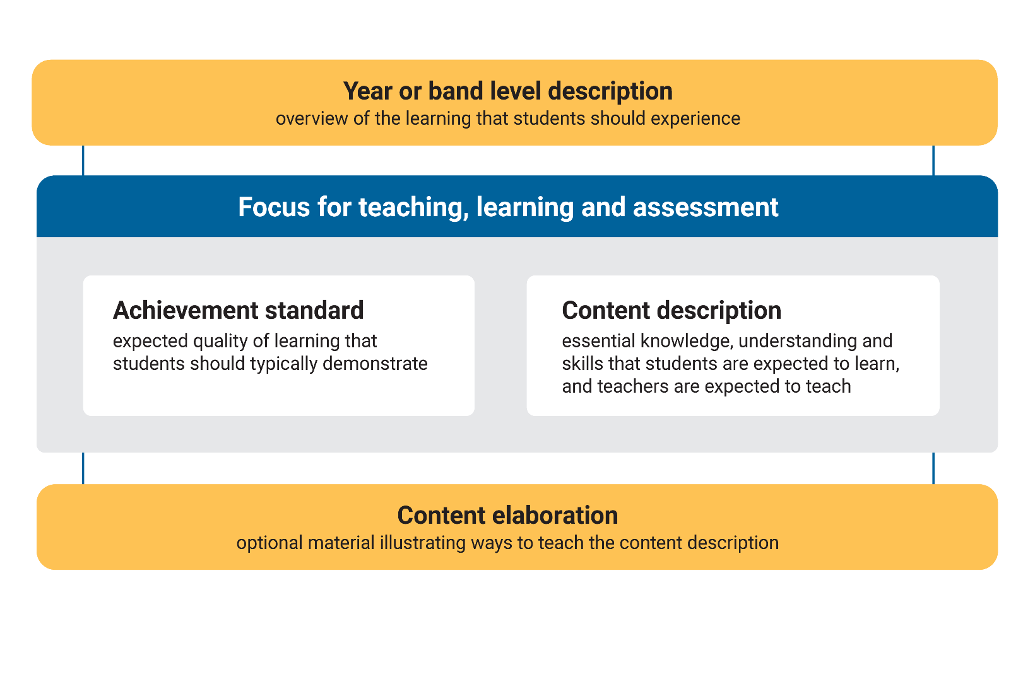
The learning areas
In small groups, discuss how each element currently influences the decision-making process when planning using the Australian Curriculum.
Notes:
Speaker notes
Understanding the elements of the curriculum for each learning area and how they might be used effectively supports successful planning for teaching and learning.
The description for each year level provides an overview of the learning students should experience.
The achievement standards and content descriptions are the essential parts of the learning area curriculum and form the basis for teaching, learning and assessment.
The content elaborations are optional suggestions and possible illustrations of ways the content descriptions might be taught.
Discussion
In small groups, discuss how each element currently influences the decision-making process when planning using the Australian Curriculum.

Slide 8

Understand this learning area
How would you use the information in ‘Understand this learning area’ when planning for teaching and learning?
How are your current teaching and learning programs delivering on the aims of the learning area?
Discuss your reflections in small groups, with an option to share your observations with the wider group.
8
Notes:
To prepare for this part of the presentation, review and adapt the text on screen for your school context.
Speaker notes
Participants read and reflect on the ‘Understand this learning area’ section for a familiar learning area. This information can be found when accessing the curriculum content for each learning area on the Australian Curriculum website.
Use the questions or screen or create your own to prompt discussion and reflection.
Discussion
Participants discuss their reflections in small groups, with an option to share their observations with the wider group.

Slide 9

General capabilities video
Consider ways you might use the connections between the learning areas and the general capabilities when planning.
Notes:
General Capabilities Video https://s7ap1.scene7.com/s7viewers/html5/VideoViewer.html?asset=australiancurriculum/General capabilities-AVS
This link will open in a separate browser.
Speaker notes
The general capabilities establish knowledge, skills, behaviours and dispositions that will support students to become lifelong learners who can effectively navigate the world of work and their future.
Participants watch the general capabilities video and consider the examples of the relationships and connections between the learning areas and the general capabilities provided in the video.
Discussion
Encourage participants to suggest ways they might use the connections between the learning areas and the general capabilities when planning.

Slide 10
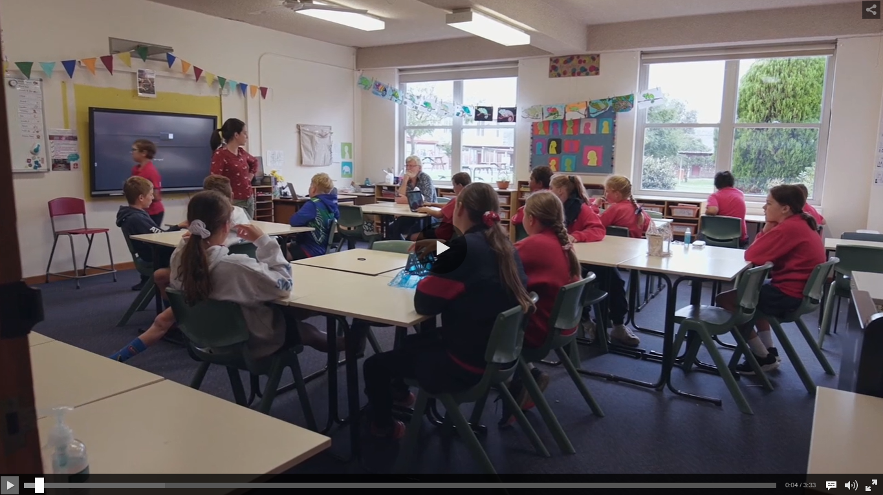
Cross-curriculum priorities video
Consider ways you might use the connections between the learning areas and the cross-curriculum priorities when planning.
Notes:
Cross-curriculum priorities – Video https://s7ap1.scene7.com/s7viewers/html5/VideoViewer.html?asset=australiancurriculum/Cross-curriculum priorities-AVS
This link will open in a separate browser.
Speakers’ notes
Cross-curriculum priorities support the Australian Curriculum to be a relevant, contemporary and engaging curriculum that reflects national, regional and global contexts.
Participants watch the cross-curriculum priorities video and consider the examples of the relationships and connections between the learning areas and the cross-curriculum priorities provided in the video.
Discussion
Encourage participants to suggest ways they might use the connections between the learning areas and the general capabilities when planning.

Slide 11

Planning for action
What are 3 actions that could improve the way we use the Australian Curriculum when planning?
Write one idea per sticky note.
Post your ideas on a large surface, like a wall or board.
As a group, sort the ideas into categories of similar actions.
Review the categories created.
11
Notes:
Speaker notes
This session will support participants to contribute to and collaborate on actions for change or improvement.
Provide participants with sticky notes to record their responses to the posed question.
After participants have had time to reflect and record their responses, review the suggestions and identify common themes or categories.
Are there common ideas or approaches for improvement? What are they?
How might the identified categories influence a whole-school approach to curriculum implementation?
Activity
Participants respond to the question on screen.
Write one idea per sticky note.
Using a large surface, like a wall or board, have participants post their ideas.
As a group, sort ideas into categories of similar actions.
Review the categories created.

Slide 12
Prioritising actions
Dot voting
Indicate your preferences using dots:
3 dots for your 1st preference
2 dots for your 2nd preference
1 dot for your 3rd preference.
12
Notes:
Speaker notes
As a group, review and prioritise actions from the previous activity. Use the dot voting activity to support participants to prioritise actions. Use the highest ranked actions as the basis for creating an action plan for your implementation approach.
Activity
Dot voting – How to use it:
Display the options identified in the previous activity in an area accessible to participants. This may be on a wall or a table. Ask participants to indicate which action they would undertake by using dots to vote for their preferred options.
Participants indicate their preferences using dots:
3 dots for their 1st preference
2 dots for their 2nd preference
1 dot for their 3rd preference.
Note: Dots may be replaced with ticks or marks.
The activity could be varied so that participants add a sticky note to their preferred option with a concise explanation for why it is their preference.

Slide 13

Action plan – actions, responsibilities and timelines
What actions will we implement?
13
Notes:
Speaker notes
Use the prioritised actions from the previous activity to start planning the whole-school approach. Use existing planning documents or complete the relevant columns in the action plan to:
describe what actions will be undertaken
allocate responsibilities
schedule actions over a specific timeframe
identify what resources are needed.
Activity
As a whole group, consider the top priority actions. Allocate roles through self-nomination or allocation of activities to teams within the school. Support participants to discuss the timing of each action with consideration of existing commitments. Consider how other priorities identified might also be included in the plan.

Slide 14
Action plan – evidence and evaluation
How will we reflect on our approach and evaluate its effectiveness over time?
Think–Pair–Share
Think independently about a prompt or problem.
Pair up and discuss your ideas with a colleague.
Share your ideas with the group.
14
Notes:
Speaker notes
Use the Action planning document to describe:
what success will look like
what evidence will need to be gathered
what the review and evaluation cycle will look like in your school.
Use the Think–Pair–Share activity or similar to support participants to contribute to the evaluation planning process.
Activity and discussion
Think–Pair–Share: how to use it
Participants:
Think independently about a prompt or problem.
Pair up and discuss their ideas with a colleague.
Share their ideas with the group.
Once sharing has been completed, use contributions to record evaluation approaches in the action plan. Consider what resources will be used as you put the plan into action and record.

Slide 15
Building teacher capability
What support do you need to build your capability in understanding and using the Australian Curriculum? ​
What support could you provide to help others build their capability in understanding and using the Australian Curriculum?
Notes:
Speaker notes
When planning to implement the curriculum, it is important to consider how all aspects of curriculum implementation are interconnected and what support teachers need.
Reflection
Ask participants to reflect on the information provided in the session and identify their strengths and areas where they need additional support.
These reflections may form part of discussions with team leaders on individual goal setting. They can support identifying areas that may be the focus for future professional learning.

Slide 16

Thank you
For more resources visit the Resources page on the Australian Curriculum website.

