Slide 1



Instructions for facilitators
Review the facilitator notes and ensure you have made any necessary changes to the PowerPoint slides.
Discussion points through the presentation will be identified using this icon.
When planning the presentation, consider time required for discussions and the timing of the whole presentation.
This presentation includes a review of a whole-school approach to sequencing learning. Consider whether the participants may need the information to review before the presentation, as it includes advice and resources developed by AITSL and AERO.

Slide 2
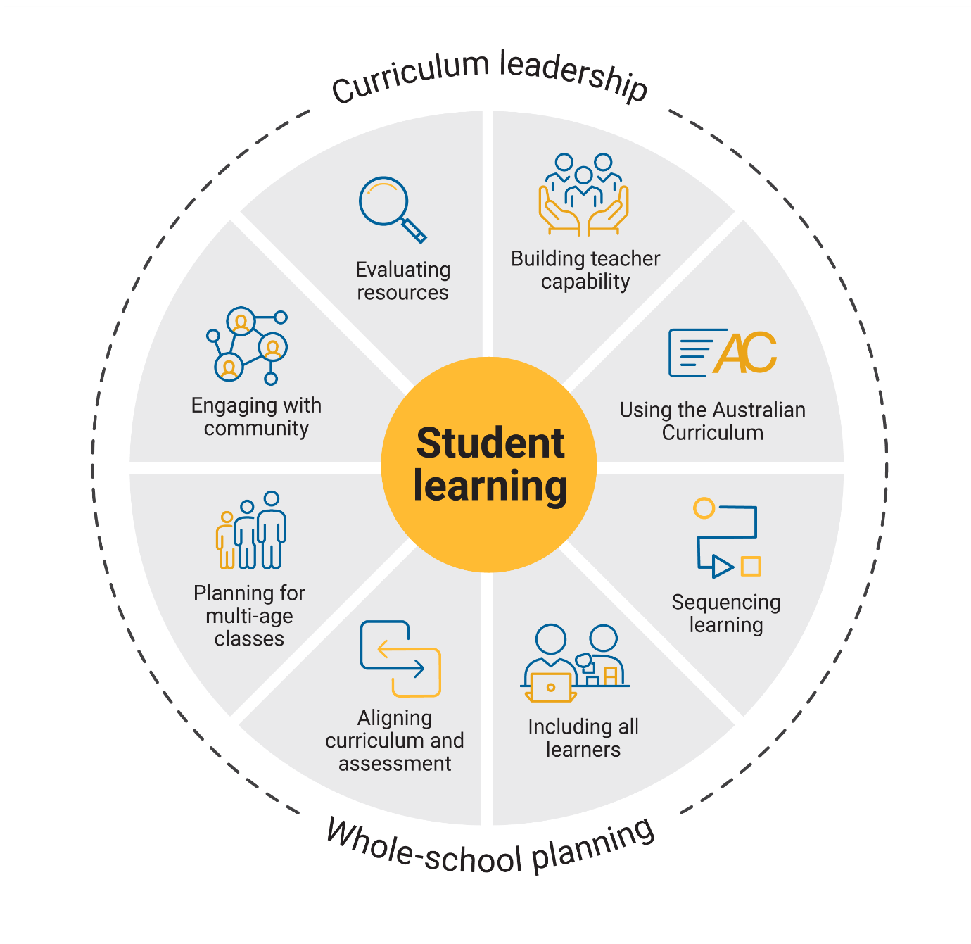

Sequencing learning

Slide 3

Outcomes
By the end of this workshop, we will be able to:
reflect on current approaches to sequencing learning within and across learning areas
consider a whole-school approach to sequencing learning
propose actions for change or improvement.
3
Notes:
Speaker notes:
Clarifying expected learning up front helps keep discussions focused and supports good decision-making.
NOTE: To prepare for this part of the presentation, review and adapt the text on screen for your school context.

Slide 4
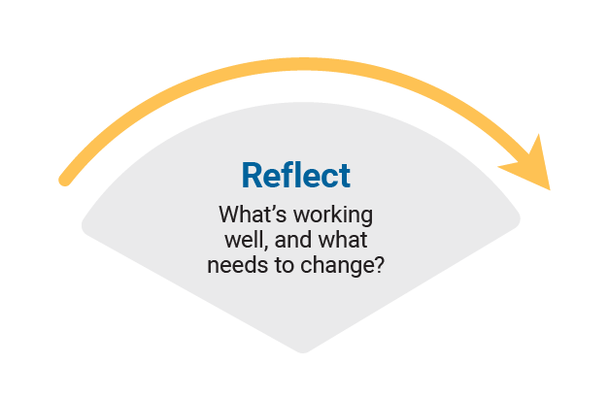
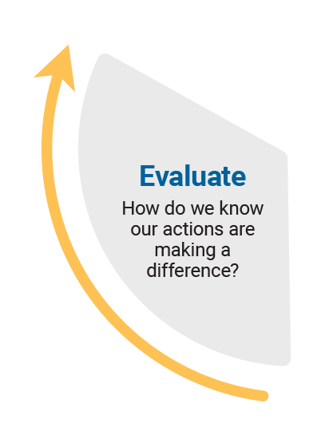
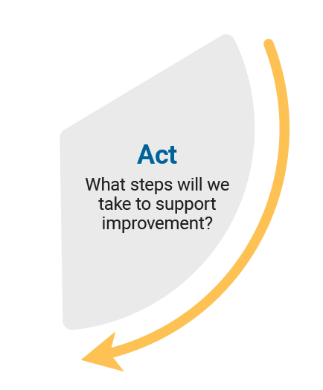
Reflect–Act–Evaluate
Reflect: identify current practice and needs.
Act: use insights from the reflect phase to determine actions to be taken.
Evaluate: identify the measures for evaluation and schedule evaluation points.
Notes:
Speaker notes
Explain to participants that the presentation will focus on the Reflect–Act–Evaluate cycle.
This is an opportunity for all participants to:
provide their insight into current practice
contribute to and enact whole-school plans
offer their observations and feedback in the evaluation process.
Explain the purpose of each stage.
Reflect: identify current practice and needs.
Act: use insights from the reflect phase to determine actions to be taken.
Evaluate: identify the measures for evaluation and schedule evaluation points.

Slide 5

Sequencing learning
What does the effective sequencing of learning look like at our school?
Do we review yearly learning sequences by considering:
the aims of each learning area
why certain content is taught at specific times
how different learning areas or subjects connect
where the order is essential and where flexibility is possible?
Popcorn activity​
Reflect on the prompt question.​
Share your ideas. ​
Review and discuss. ​
Identify common themes.
5
Notes:
Speaker notes
Support participants to reflect on current approaches to sequencing learning. When reviewing responses, consider if any common challenges or strengths have been identified by the group.
Note: to prepare for this activity, select a question to be displayed on screen or create a question as a focus for reflection on current practice. Examples have been provided.
Activity
Popcorn: how to use it
A fast-paced group strategy where everyone contributes ideas aloud in real time.
Present a problem or question.
Give a minute for silent reflection.
Invite participants to share (one at a time) while 1 or 2 people record.
Stop when ideas slow down, then review and discuss.
Review responses as a whole group to identify themes.
Note: to prepare for this activity, select a question to be displayed on screen or create a question as a focus for reflection on current practice. Examples have been provided.

Slide 6

A whole-school approach to sequencing learning
Compass points
E = Excited
What excites you about this idea or propositions? What’s the upside?
W = Worrisome
What do you find worrisome about this idea or proposition? What’s the downside?
N = Need to know
What else do you need to know or find out about this idea or proposition? What additional information would help you to evaluate things?
S = Stance or Suggestion for moving forward
What is your current stance or opinion
on the idea or proposition? How might
you move forward in your evaluation
of this idea or proposition?
6
Notes:
Speaker notes
In pairs or small groups, ask participants to review the “Whole-school approach to sequencing learning”. As they make their way through the material, ask them to use the compass points prompts to record their thinking or discussions. Allow 20–30 minutes for review and discussion as the process includes links to resources and advice developed by AITSL and AERO.
Bring the group back together and work through each compass point, encouraging participants to share their observations and discussions. Record observations in a shared space where all participants can review and reflect on common ideas and themes.
Activity
Compass points: how to use it
E = Excited
What excites you about this idea or propositions? What’s the upside?
W = Worrisome
What do you find worrisome about this idea or proposition? What’s the downside?
N = Need to know
What else do you need to know or find out about this idea or proposition? What additional information would help you to evaluate things?
S = Stance or Suggestion for moving forward
What is your current stance or opinion on the idea or proposition? How might you move forward in your evaluation of this idea or proposition?
A THINKING ROUTINE FROM PROJECT ZERO, HARVARD GRADUATE SCHOOL OF EDUCATION

Slide 7

Prioritising actions
Diamond 9
What are 3 actions that could improve the
way we sequence learning across the school?
Individual brainstorm: write down your priorities or solutions on sticky notes.
Group sharing: place all sticky notes on a wall or table so everyone can see them. This allows for easy comparison and discussion.
Theme and merge: sort the sticky notes into themes by grouping similar ideas. Blend overlapping ideas into shared statements.
Rank the themes: use the Diamond 9 layout
  Top row (3) – highest priorities
  Middle row (3) – medium priorities
  Bottom row (3) – lower priorities
  Discuss and agree on placement as a group.
7
Notes:
Speaker notes
Use the diamond 9 activity to support participants to identify and prioritise actions. Use the highest ranked actions as the basis for creating an action plan for your implementation approach.
Activity
Using the Diamond 9 approach, provide participants with opportunities to share their individual ideas. Group common ideas to prioritise actions.
Diamond 9: how to use it
Individual brainstorm: each participant writes down their priorities or solutions on sticky notes. Optional: use different coloured sticky notes to show levels of priority.
Group sharing: place all sticky notes on a wall or table so everyone can see them. This allows for easy comparison and discussion.
Theme and merge: as a group, sort the sticky notes into themes by grouping similar ideas. Blend overlapping ideas into shared statements.
Rank the themes: use the Diamond 9 layout
Top row (3) – highest priorities
Middle row (3) – medium priorities
Bottom row (3) – lower priorities
Discuss and agree on placement as a group.
CURRICULUM DESIGN TOOLKIT ACTIVITY FROM EDUCATION SCOTLAND

Slide 8

Action plan – actions, responsibilities and timelines
What actions will we implement?
8
Notes:
Speaker notes
Use the prioritised actions from the previous activity to start planning the whole-school approach. Use existing planning documents or complete the relevant columns in the action plan to:
describe what actions will be undertaken
allocate responsibilities
schedule actions over a specific timeframe
identify what resources are needed.
Activity
As a whole group, consider the top priority actions. Allocate roles through self-nomination or allocation of activities to teams within the school. Support participants to discuss the timing of each action with consideration of existing commitments. Consider how other priorities identified might also be included in the plan.

Slide 9
Action plan – evidence and evaluation
How will we reflect on our approach and evaluate its effectiveness over time?
Think about the question.
Pair up and discuss your ideas with a colleague.
Share your ideas with
the group.
9
Notes:
Speaker notes
Use the Action planning document to describe:
what success will look like
what evidence will need to be gathered
what the review and evaluation cycle will look like in your school.
Use the Think–Pair–Share activity or similar to support participants to contribute to the evaluation planning process.
Activity and discussion
Think–Pair–Share: how to use it
Participants think independently about a prompt or problem.
Participants pair up and discuss their ideas with a colleague.
Participants share their ideas with the group.
Once sharing has been completed, use contributions to record evaluation approaches in the action plan. Consider what resources will be used as you put the plan into action and record.

Slide 10
Building teacher capability
What support do you need to build your capability when sequencing learning? ​
What support could you provide to help others build their capability when sequencing learning?
Notes:
Speaker notes
When planning to implement the curriculum, it is important to consider how all aspects of curriculum implementation are interconnected and what support teachers need.
Reflection
Ask participants to reflect on the information provided in the session and identify their strengths and areas where they need additional support. These reflections may form part of discussions with team leaders on individual goal setting. They can support identifying areas that may be the focus for future professional learning.

Slide 11

Thank you
For more resources visit the Resources page on the Australian Curriculum website.

