Slide 1



Instructions for facilitators
Review the facilitator notes and make any necessary changes to the PowerPoint slides.
Discussion points through the presentation will be identified using this icon. When planning the presentation, consider the timing of the whole presentation, including time required for discussions.
This presentation takes the participants through each aspect of curriculum implementation. Facilitators may need to consider breaking the presentation up over several sessions.

Slide 2
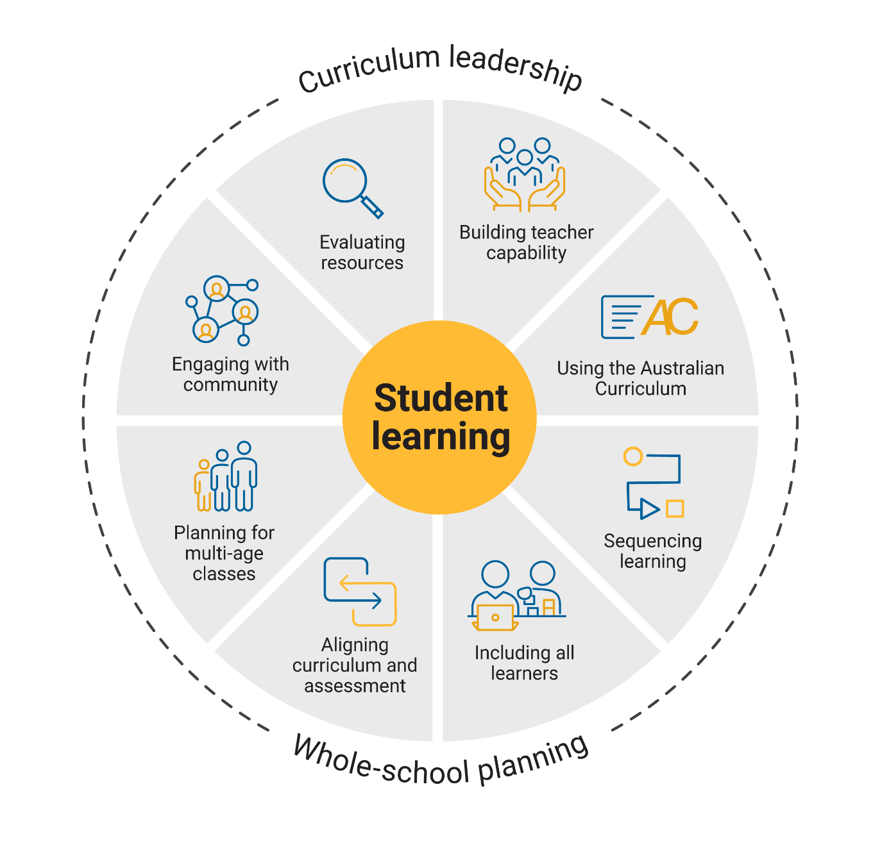

Building teacher
capability
Notes:
Speaker notes
This presentation will focus on supporting participants to reflect on their knowledge of the curriculum for the learning areas and year levels they teach. It will provide an opportunity for participants to identify what they want to learn more about in relation to curriculum implementation.

Slide 3

Outcomes
By the end of this workshop, we will have:
reflected on current approaches to curriculum implementation
identified areas of strength, both personally and collectively
planned for building personal and collective capability when implementing the curriculum.
3
Notes:
Speaker notes
Clarifying expected learning up front helps keep discussions focused and supports good decision-making.
NOTE: To prepare for this part of the presentation, review and adapt the text on screen for your school context.

Slide 4
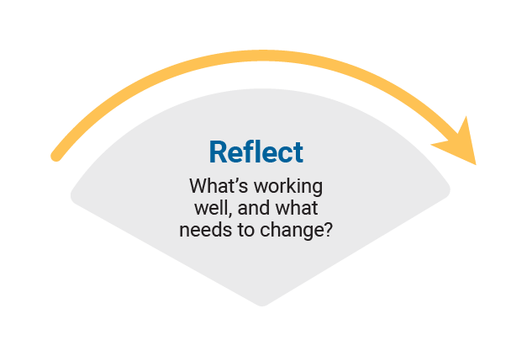
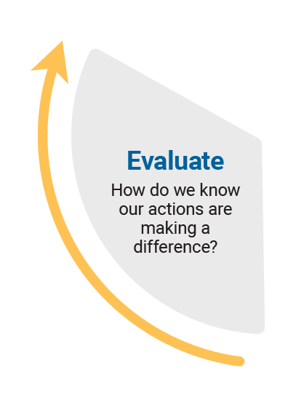
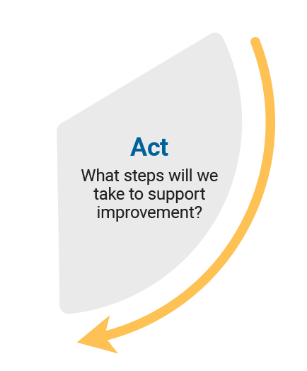
Reflect–Act–Evaluate
Reflect: identify current practice and needs.
Act: use insights from the reflect phase to determine actions to be taken.
Evaluate: identify the measures for evaluation and schedule evaluation points.
Notes:
Speaker notes
Explain to participants that the presentation will focus on the Reflect–Act–Evaluate cycle.
This is an opportunity for all participants to:
provide insight into their current practice
contribute to and enact whole-school plans
offer their observations and feedback during the evaluation process.
Explain the purpose of each stage.
Reflect: identify current practice and needs.
Act: use insights from the reflect phase to determine actions to be taken.
Evaluate: identify the measures for evaluation and schedule evaluation points.

Slide 5
Whole-school curriculum planning
Notes:
Speaker notes:
Schools use the Australian Curriculum to plan for student learning at many levels. These include planning for whole-school curriculum, year-level, learning area/subject, unit, classroom and lesson, and individual student. A whole-school approach to curriculum planning increases and promotes consistency, which supports teachers in improving outcomes for all students.
Eight aspects of curriculum implementation have been identified for schools to consider as they implement the Australian Curriculum.
This presentation, focused on building teacher capability, is an opportunity for participants to reflect on what they know and what they need to know more about in relation to each aspect.
The 8 aspects are:
Building teacher capability
Using the Australian Curriculum
Sequencing learning
Including all learners
Aligning curriculum and assessment
Planning for multi-age classes
Engaging with community
Evaluating resources.
Provide participants with a copy of the reflection record. At the end of each activity, encourage participants to reflect on their strengths and where they would like further support.

Slide 6
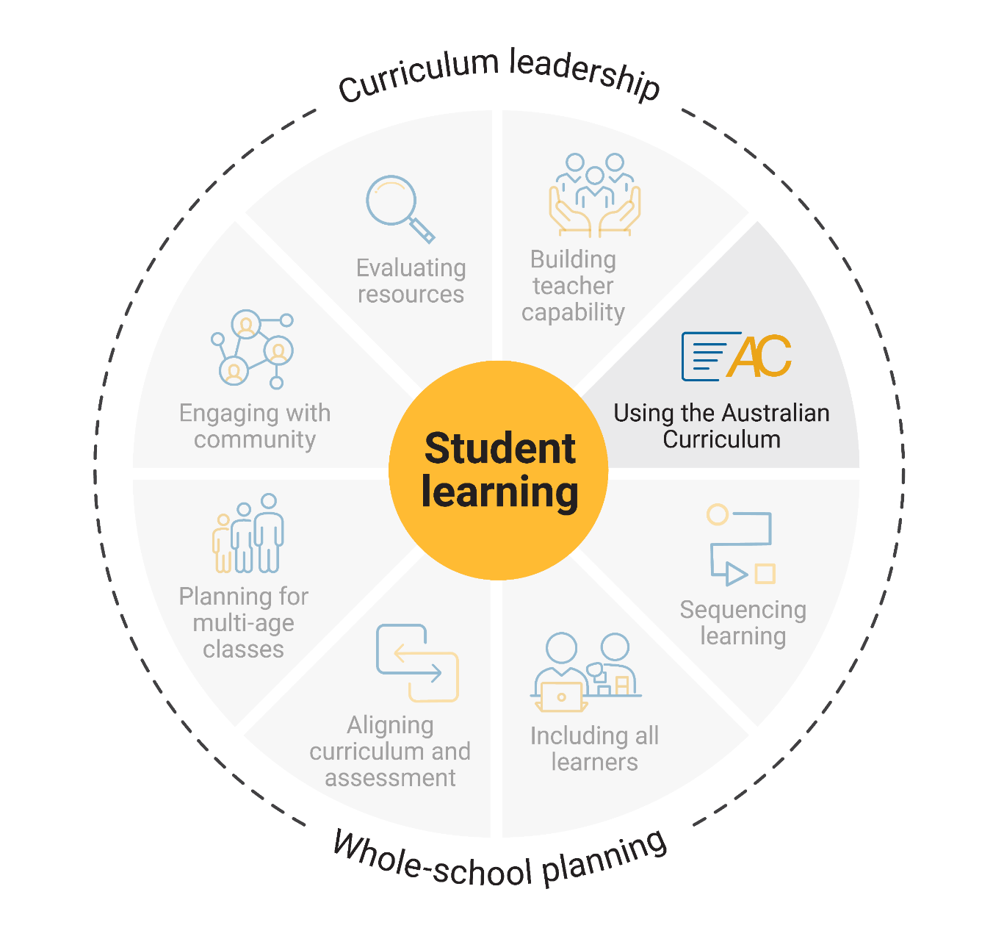
Using the Australian Curriculum
What do we understand about the structure and intent of the Australian Curriculum?
Learning areas
General capabilities
Cross-curriculum priorities.
Notes:
Speaker notes:
The Australian Curriculum sets the expectations for what all students should be taught, regardless of their background or where they live. The Australian Curriculum has 3 parts or dimensions – learning areas, general capabilities and cross-curriculum priorities. Teachers with sound knowledge and understanding of the learning areas they teach are better able to consider the opportunities to embed the general capabilities and cross-curriculum priorities when planning for student learning.

Slide 7

Australian Curriculum
Jigsaw adaptation
Form 3 groups.
Each group will review a different resource and discuss how this information might improve current practice.
Each group will present back to the whole group with the key points from their discussion.
7
Notes:
Speaker notes
Use an adaptation of the jigsaw activity to promote discussion and reflection on current practice.
Activity
Jigsaw adaptation: how to use it
Organise participants into 3 groups.
Assign each group a different resource to review and discuss how this information might improve current practice.
Have each group present back to the whole group with the key points from their discussion.
Resources to review
Learning areas tab from Using the Australian Curriculum aspect
General capabilities tab from Using the Australian Curriculum aspect
Cross-curriculum priorities tab from Using the Australian Curriculum aspect
Participants use the reflection record to identify their strengths and where they would like further support.

Slide 8
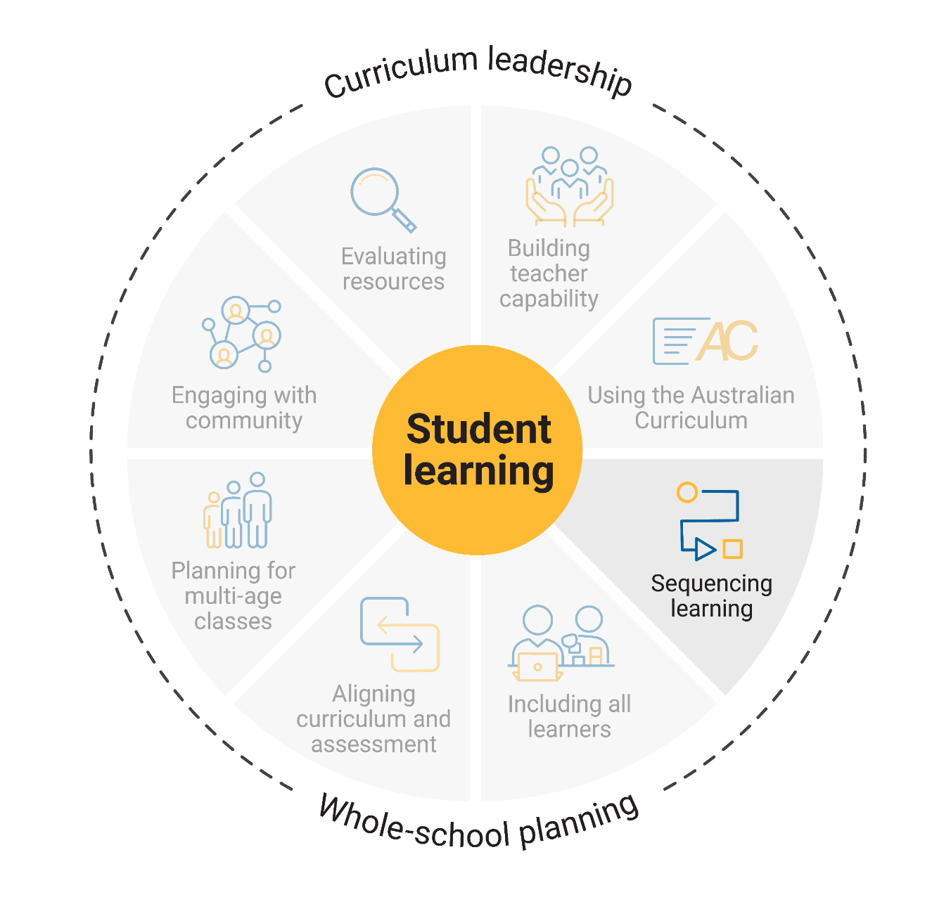
Sequencing learning
How do we sequence the curriculum and evaluate the effectiveness of our approaches?
In small groups, review the Whole-school approach to sequencing learning and discuss how this information might improve current practice.
Notes:
Speaker notes:
Sequencing learning within year levels is a foundational step in whole-school curriculum planning. It involves structuring what is taught, when and in what order, so that knowledge and skills build logically.
A whole-school curriculum plan makes this sequence visible. Aligned to the Australian Curriculum, it outlines the progression of content and achievement standards for each subject. It shows how learning connects across years and learning areas.
Activity and discussion
In small groups, participants review the Whole-school approach to sequencing learning and discuss how this information might improve current practice. Ask each group to identify a step or an action they wish to investigate further. Share these with the wider group either through discussion or recording and displaying ideas on sticky notes.
Participants use the reflection record to identify their strengths and where they would like further support.

Slide 9

Including all learners
How do we ensure all learners are supported to access the curriculum?
Review the information about the CASE model on the Planning for diversity page.
How might the application of the CASE model strengthen existing practice.
Notes:
Speaker notes:
The Curriculum, Abilities, Standards, Evaluate (CASE) model provides a structured approach to planning inclusive and equitable teaching, learning and assessment opportunities for all learners. It ensures that all learners can access content and participate in learning on the same basis as their peers. Using the CASE model enables teachers to implement the Australian Curriculum in ways that are responsive to unique school contexts and the identities, abilities and experiences of all learners.
Review and discussion
Ask participants to review the information about the CASE model on the Planning for diversity page. Participants reflect on their current approaches to planning for all learners and identify where the application of the CASE model might strengthen existing practice.
Participants use the reflection record to identify their strengths and where they would like further support.

Slide 10
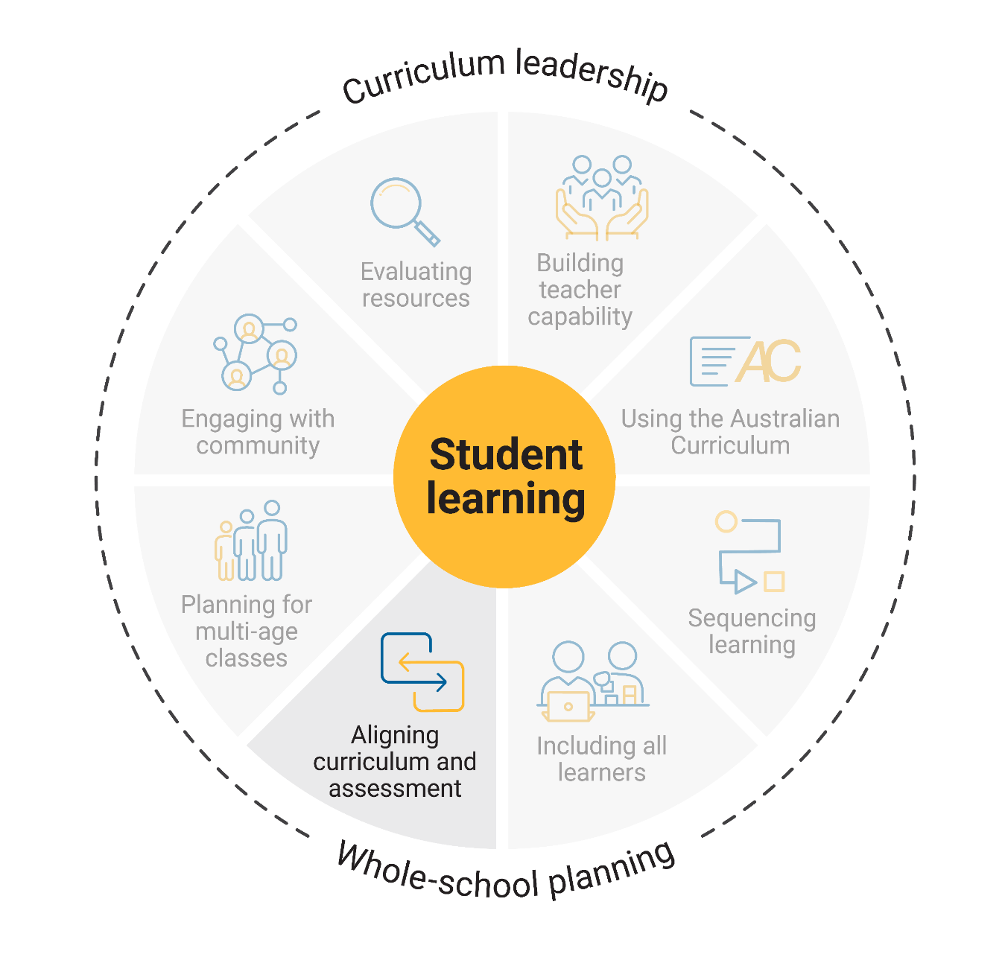
Aligning curriculum and assessment
How do we ensure our approaches to assessment align to the curriculum?
At the end of the video, reflect on current practice and share your observations and thinking with the group.
Notes:
Speaker notes
Aligning curriculum and assessment is a core part of whole-school approaches to curriculum implementation. Assessment provides the evidence needed to evaluate student learning, measure progress against the achievement standards, and assess the impact of teaching, learning and curriculum strategies.
Review and discussion
As participants watch the video, ask them to use a PMI chart or similar recording tool to record their thinking. Use a prompt such as ‘How do we ensure our approaches to assessment align to the curriculum?’ to support reflection.
At the end of the video, encourage participants to reflect on current practice and share their observations and thinking with the wider group.
Participants use the reflection record to identify their strengths and where they would like further support.

Slide 11
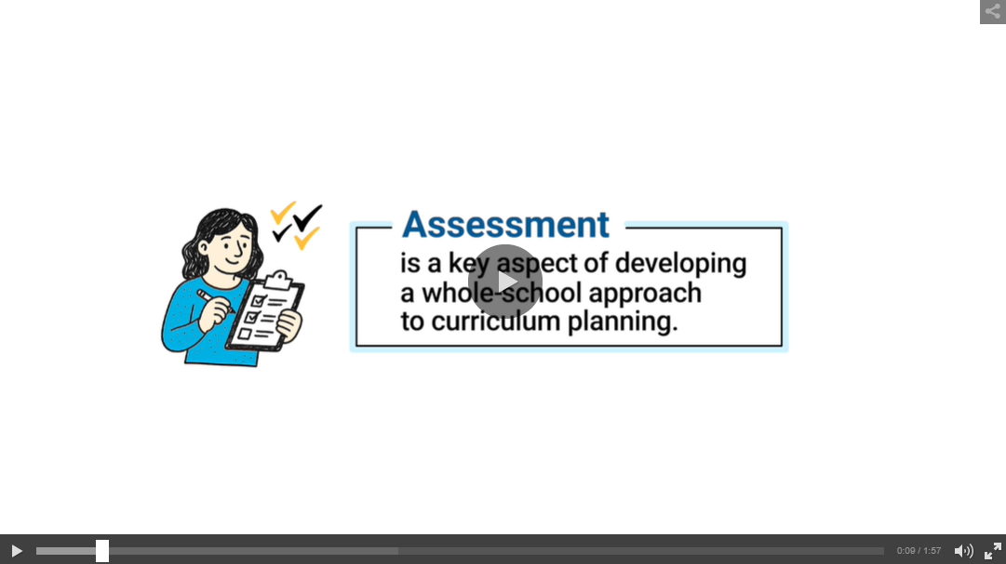
Aligning curriculum and assessment video
Watch Aligning curriculum and assessment video
Notes:
Aligning curriculum and assessment video: https://s7ap1.scene7.com/s7viewers/html5/VideoViewer.html?asset=australiancurriculum/Aligning curriculum and assessment-AVS
This link will open in a separate browser

Slide 12

Planning for multi-age classes
Notes:
Speaker notes:
Consider whether reviewing this aspect is suitable for your context. If your school does not have multi-age classes (where students of different age groups, spanning more than one year level, are placed together in a single class), this and the next slide should be removed from the presentation.

Slide 13
Planning for multi-age classes
Jigsaw adaptation
Form 3 groups.
Each group will review a different resource and discuss how this information might support improving current practice.
Each group will present back to the whole group with the key points from their discussion.
13
Notes:
Speaker notes
Planning for learning in multi-age classes is complex. It requires collaboration among teachers, knowledge of the curriculum structure, careful sequencing of content, and an agreed approach to recording and evaluating curriculum plans. When school and curriculum leaders have a clear understanding of the different approaches to managing curriculum, they are better able to lead whole-school curriculum planning in multi-age contexts.
Use an adaptation of the jigsaw activity to promote discussion and reflection on current practice.
Activity and discussion
Jigsaw adaptation – How to use it:
Organise participants into 3 groups.
Assign each group a different resource to review and discuss how this information might improve current practice.
Have each group present back to the whole group with the key points from their discussion.
Resources to review
Conceptual threads model tab from Planning for multi-age classes aspect
A/B model tab from Planning for multi-age classes aspect
Split models tab from Planning for multi-age classes aspect
Participants use the reflection record to identify their strengths and where they would like further support.

Slide 14

Engaging with community
How do we communicate and collaborate with our school community about our approaches to curriculum implementation?
Families
First Nations Australian communities
Other community groups
Notes:
Speaker notes:
Effective curriculum planning requires collaboration with families, local First Nations Australian communities and the wider school community. When considering approaches to community engagement, schools need to be clear on the purpose for the engagement, who they will engage with and how they will engage.

Slide 15
Engaging with community
How do we communicate and collaborate with our school community about our approaches to curriculum implementation?
Think–Pair–Share
Think independently about a prompt or problem.
Pair up and discuss your ideas with a colleague.
Share your ideas with the group.
15
Notes:
Speaker notes
Use the Think–Pair–Share activity and ask participants to reflect on the current approaches to engaging with each of the groups on screen.
Activity and discussion
Use the Think–Pair–Share activity to support teachers to reflect on how they engage with the broader community. Using the on-screen question as a prompt, consider the ways in which communication and collaboration occur with each of the groups on screen.
Think–Pair–Share: how to use it
Participants think independently about a prompt or problem.
Participants pair up and discuss their ideas with a colleague.
Participants share their ideas with the group.
Sharing may consist of only one idea or statement from each group for larger teams or using digital tools to record responses.
Participants use the reflection record to identify their strengths and where they would like further support.

Slide 16
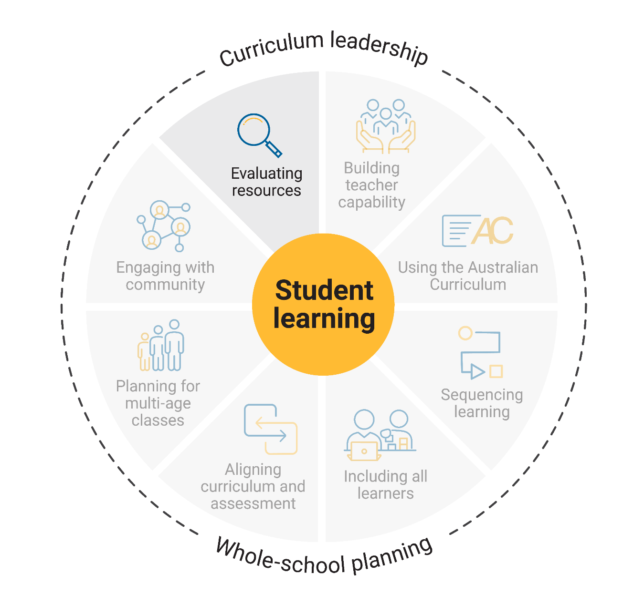
Evaluating resources
How do we review and evaluate the resources we use for teaching, learning and assessment?
In small groups, discuss the ways in which resources are currently evaluated.
Notes:
Speaker notes
Evaluating teaching, learning and assessment resources ensures that educational materials are high quality and align with the Australian Curriculum achievement standards and content descriptions. Educational resources encompass everything a school needs to support quality teaching and learning.
Review and discussion
Using the question on screen, ask small groups to discuss the ways in which resources are currently evaluated. Share observations and thinking with the whole group.
Participants use the reflection record to identify their strengths and where they would like further support.

Slide 17

Building teacher capability
What support do you need to build your capability in understanding and using the Australian Curriculum?
What support could you provide to help others build their capability in understanding and using the Australian Curriculum?
Notes:
Speaker notes
When planning to implement the curriculum, it is important to consider how all aspects of curriculum implementation are interconnected and what support teachers need. Ask teachers complete the reflection record while considering the prompts on screen.
Review and discussion
Throughout the presentation, participants have reflected on their strengths and areas where they would like support. These reflections may form part of discussions with school and curriculum leaders on individual goal setting. They can support identifying areas that may be the focus for future professional learning.

Slide 18

Thank you
For more resources visit the Resources page on the Australian Curriculum website.

