Slide 1


Instructions for facilitators
Review the facilitator notes and make any necessary changes to the PowerPoint slides.
Discussion points through the presentation will be identified using this icon.
When planning the presentation, consider the timing of the whole presentation, including time required for discussions.

Slide 2


Aligning curriculum and assessment
Notes:
Speaker notes
This presentation will focus on supporting participants to reflect on their knowledge of the curriculum and how they align curriculum and assessment in the classroom. It will provide an opportunity for participants to identify what they want to learn more about in relation to curriculum aligned assessment.

Slide 3

Outcomes
By the end of this workshop, we will have:
considered a process for aligning curriculum and assessment
reflected on current approaches to aligning curriculum and assessment
proposed actions for change or improvement.
3
Notes:
Speaker notes:
Clarifying expected learning up front helps keep discussions focused and supports good decision-making.
NOTE: To prepare for this part of the presentation, review and adapt the text on screen for your school context.

Slide 4
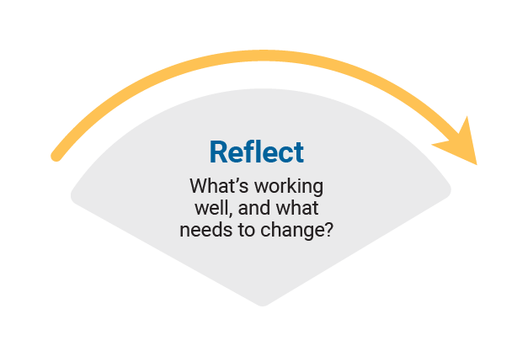
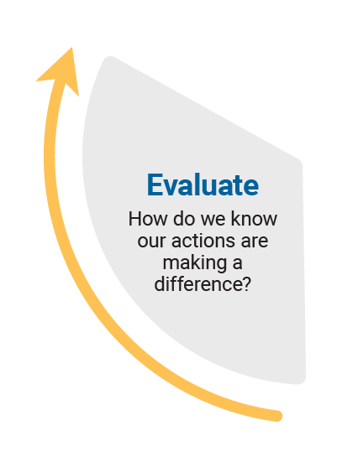
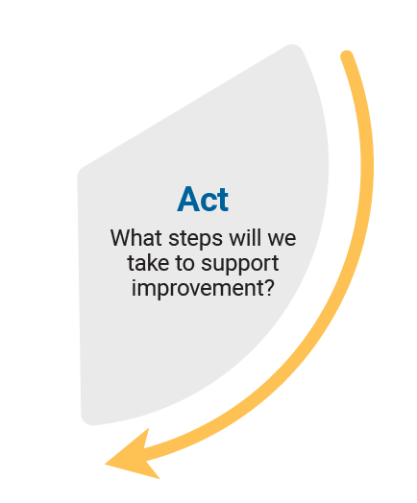
Reflect-Act-Evaluate
Reflect: identify current practice and needs.
Act: use insights from the reflect phase to determine actions to be taken.
Evaluate: identify the measures for evaluation and schedule evaluation points.
Notes:
Speaker notes
Explain to participants that the presentation will focus on the Reflect–Act–Evaluate cycle.
This is an opportunity for all participants to:
provide their insight into current practice
contribute to and enact whole-school plans
offer their observations and feedback in the evaluation process.
Explain the purpose of each stage.
Reflect: identify current practice and needs.
Act: use insights from the reflect phase to determine actions to be taken.
Evaluate: identify the measures for evaluation and schedule evaluation points.

Slide 5

A process for aligning curriculum and assessment
Notes:
Aligning curriculum and assessment Video - A process for aligning curriculum and assessment
https://s7ap1.scene7.com/s7viewers/html5/VideoViewer.html?asset=australiancurriculum/Aligning curriculum and assessment-AVS
The video opens in a separate browser
Speaker notes
The Australian Curriculum achievement standards describe the expected quality of learning students should typically demonstrate at the end of each year level or band of years.
Content descriptions are directly connected to the achievement standard statements. They specify the essential knowledge, understanding and skills that students are expected to learn.
Effective assessment practices use both the achievement standards and the content descriptions.
Ask participants to watch the video and reflect on current practice in relation to each step.

Slide 6

A process for aligning curriculum and assessment
Define achievement.
Plan curriculum content.
Plan summative assessments.
Plan formative assessment.
Evaluate.
6
Notes:
Speaker notes
This example process uses the achievement standards and content descriptions to plan and schedule assessments.
Define achievement. Use the achievement standards to identify and describe what students should know and be able to do by the end of a teaching and learning cycle.
Plan curriculum content. Identify the connected content descriptions that students need to learn to reach the achievement standard and consider what learning is required.​
Plan summative assessments. Design and schedule the implementation of summative assessments to provide evidence of student learning against the achievement standard.
Plan formative assessment. Design and schedule the implementation of formative assessments to gather evidence of students’ knowledge, understanding and skills to actively inform classroom teaching.
Evaluate. Evaluate assessment approaches to ensure the evidence they gave effectively supported student learning and enabled judgements about progress against the achievement standard.

Slide 7

A process for aligning curriculum and assessment
Consider a learning area you teach.
Use the Planning for assessment document to work through each step in the process. Note down ideas and possible approaches that you could take when aligning curriculum and assessment.
Share your reflections on the process with the whole group.
7
Notes:
Activity
In pairs or teaching teams, ask participants to consider a learning area they are responsible for teaching. Use the Planning for assessment document to work through each step in the process. Note down ideas and possible approaches that may be taken when aligning curriculum and assessment for the selected learning area.
Encourage participants to review other resources such as the advice on the Formative assessment page as they complete the activity.
Ask participants to share their reflections on the process with the whole group.

Slide 8

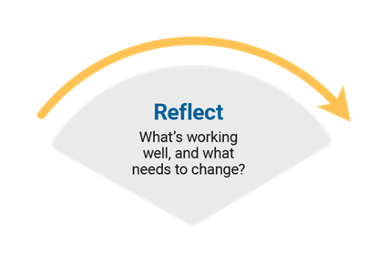
Planning for action
What current approaches are working well and where are there opportunities for change and improvement?
Think–Pair–Share
Think about the question.
Pair up and discuss your ideas with a colleague.
Share your ideas with
the group.
8
Notes:
Speaker notes
Aligning curriculum and assessment is a core part of whole-school curriculum implementation. Assessment provides the evidence needed to evaluate student learning, measure progress against the achievement standards, and assess the impact of teaching, learning and curriculum strategies.
Use the Think–Pair–Share activity to support participants to identify where there is existing good practice and to propose options for action.
Record proposed actions so they may be used in the next activity.
Sharing may consist of only one idea or statement from each group for larger teams or using digital tools to record responses.
Activity
Think–Pair–Share: how to use it
Participants:
think independently about a prompt or problem.
pair up and discuss their ideas with a colleague.
share their ideas with the group.

Slide 9
Prioritising actions
Dot voting
Indicate your preferences using dots:
3 dots for your 1st preference
2 dots for your 2nd preference
1 dot for your 3rd preference.
Use the highest ranked actions as the basis for creating an action plan for your implementation approach.
9
Notes:
Speaker notes
As a group, review and prioritise actions from the previous activity. Use the dot voting activity to support participants to prioritise actions. Use the highest ranked actions as the basis for creating an action plan for your implementation approach.
Activity
Dot voting: how to use it
Display the options identified in the previous activity in an area accessible to participants. This may be on a wall or a table. Ask participants to indicate which action they would undertake by using dots to vote for their preferred options.
Participants indicate their preferences using dots:
3 dots for their 1st preference,
2 dots for their 2nd preference
1 dot for their 3rd preference.
Note: Dots may be replaced with ticks or marks.
The activity could be varied so that participants add a sticky note to their preferred option with a concise explanation for why it is their preference.

Slide 10

Action plan – actions, responsibilities and timelines
What actions will we implement?
10
Notes:
Speaker notes
Use the prioritised actions from the previous activity to start planning the whole-school approach. Use existing planning documents or complete the relevant columns in the action plan to:
describe what actions will be undertaken
allocate responsibilities
schedule actions over a specific timeframe
identify what resources are needed.
Activity
As a group, consider the top priority actions. Allocate roles through self-nomination or allocation of activities to teams within the school. Support participants to discuss the timing of each action with consideration of existing commitments. Consider how other priorities identified might also be included in the plan.

Slide 11
Action plan – evidence and evaluation
How will we reflect on our approach and evaluate its effectiveness over time?
Think–Pair–Share
Think about the question.
Pair up and discuss your ideas with a colleague.
Share your ideas with
the group
11
Notes:
Speaker notes
Use the Action planning document to describe:
what success will look like
what evidence will need to be gathered
what the review and evaluation cycle will look like in your school.
Use the Think–Pair–Share activity or similar to support participants to contribute to the evaluation planning process.
Activity and discussion
Think–Pair–Share: how to use it
Participants think independently about a prompt or problem.
Participants pair up and discuss their ideas with a colleague.
Participants share their ideas with the group.
Once sharing has been completed, use contributions to record evaluation approaches in the action plan. Consider what resources will be used as you put the plan into action and record.

Slide 12
Building teacher capability
What support do you need to build your capability when aligning curriculum and assessment? ​
What support could you provide to help others build their capability when aligning curriculum and assessment? ​
Notes:
Speaker notes
When planning to implement the curriculum, it is important to consider how all aspects of curriculum implementation are interconnected and what support teachers need.
Reflection
Ask participants to reflect on the information provided in the session and identify their strengths and areas where they need additional support. These reflections may form part of discussions with team leaders on individual goal setting. They can support identifying areas that may be the focus for future professional learning.

Slide 13

Thank you
For more resources visit the Resources page on the Australian Curriculum website.

